Slide 1
The Road to Digital Citizenship: Providing a Foundation of Critical Thinking through an Information Evaluation Mini Course
Nina Verishagen
Saskatchewan Polytechnic Library
Notes:
Welcome everyone, my name is Nina Verishagen- I am a librarian from Treaty 6 Territory, in Saskatoon where I work at Saskatchewan Polytechnic Library. My role there is multi-faceted, I am a faculty librarian, I liaise to six disciplines, including arts & sciences and the school of adult education and literacy, I also oversee the C&M for the entire the entire library system.

Slide 2
Notes:
Before we begin, I would like to acknowledge that I am giving this presentation on Treaty 4 Territory. I would like to give thanks to the traditional caretakers of this land, the Cree, Saulteaux, Dene, Dakota, Lakota, Nakota and the Metis Nation.
My personal commitment towards truth and reconciliation in my role as a librarian is to dedicate my work towards helping our community realize the truth of the historical and ongoing harms that have occured on this land.
There is a tie between the work we are doing here – learning and teaching about disinforma tion and the historical atrocities that have occurred on Turtle Island, I hope our work in this area will help people to come to a more accurate understanding of the history of this country and enable them to move forward more responsibly

Slide 3
Disinformation: Dealing with the Disaster
Photo by Nathan Dumlao on Unsplash
Notes:
We hosted a PD session, to tell faculty about the tools- with this title, and it was very highly attended. This is a topic that grabs people’s attention, it’s something that people are interested in, it’s something they are ready for.

Slide 4
today
The disaster
The project
The response
The library

Slide 5
Headlines for the Sharing
Notes:
I’m going to take you through a quick little activity that exists within the course, that I’ve delivered in faculty PD sessions over zoom, and in a classroom setting with students.

Slide 6
How does this make you feel?

Slide 7
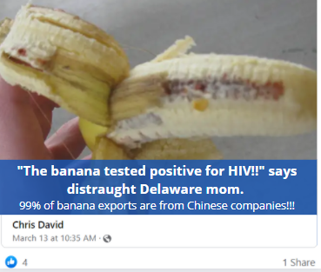
How does this make you feel?

Slide 8
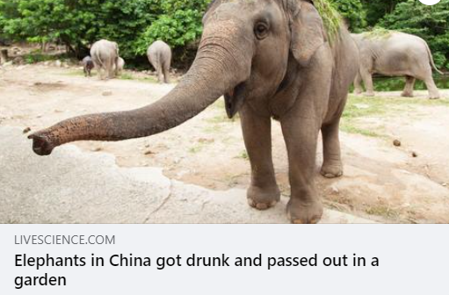
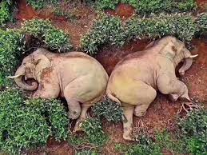
Both are “not true”, but are they both dangerous?
misinformation
disinformation
Notes:
Explanation of the two stories – what are they, why is one misinformation and one disinformation?
Elephant photo went viral after it was shared on Twitter on March 18 by Parveen Kaswan, a conservationist and an Indian Forest Service officer. Kaswan mentioned in the tweet that wild elephants have a taste for booze, quipping that these particular pachyderms had turned to alcohol "to sanitize [their] trunks," and were sleeping off the aftermath.
Have you ever seen information like these articles on your feeds? Do they incite any sort of emotion? Keep that in mind as we go through this presentation.

Slide 9
The Disaster
Notes:
We’ve already looked at a few examples of the issue at hand.

Slide 10
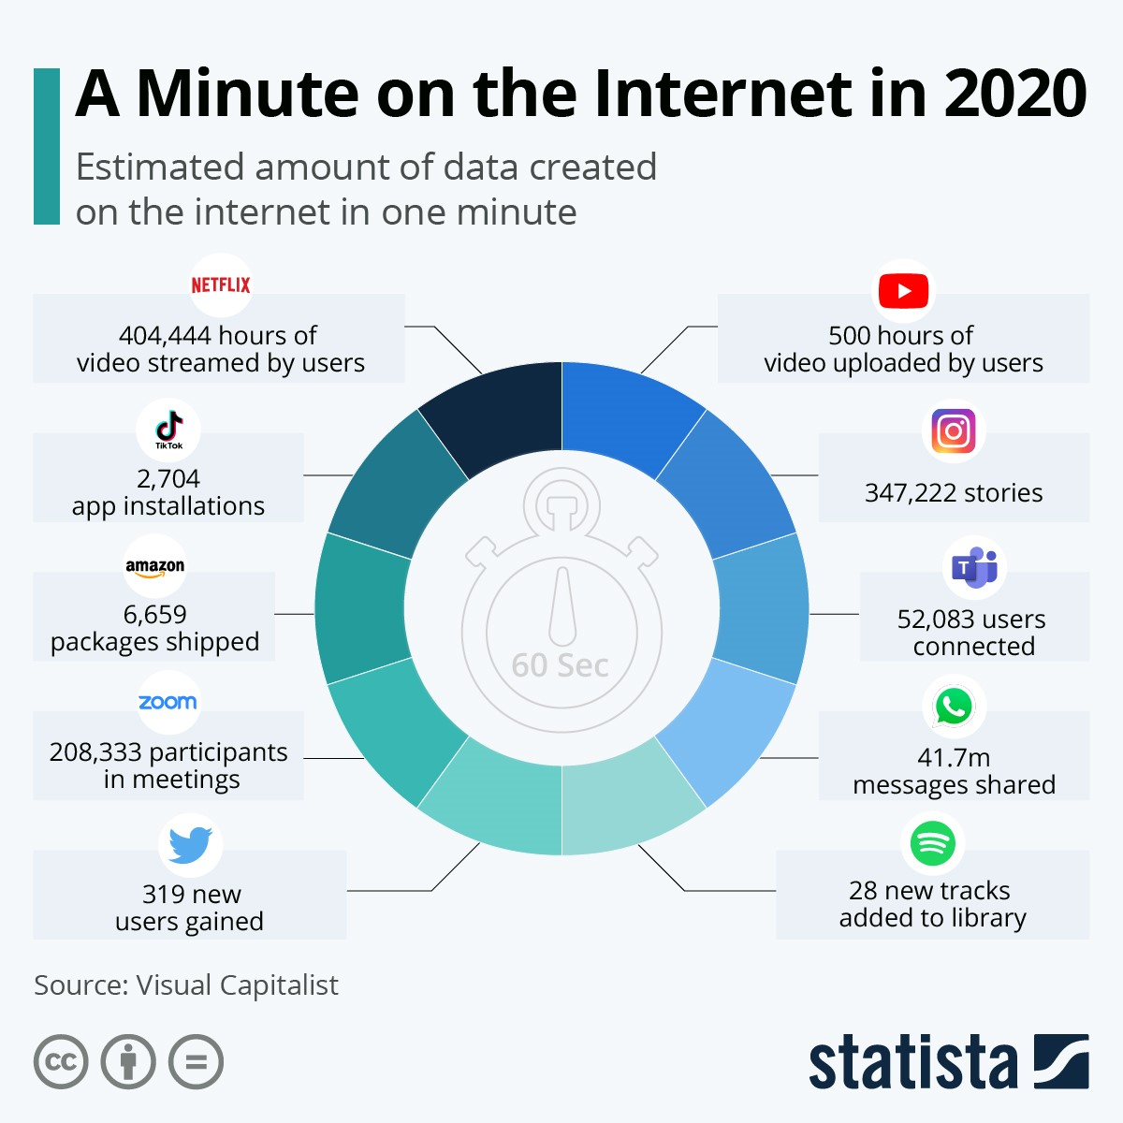
All the information
Jenik, C. (2020). A minute on the Internet in 2020. Statisa. https://www.statista.com/chart/17518/data-created-in-an-internet-minute/ [CC BY-ND].
Notes:
Jenik, C. (2020). A minute on the Internet in 2020. Statisa. https://www.statista.com/chart/17518/data-created-in-an-internet-minute/ [CC BY-ND].
Various sources have stated that by the year 2020 there would be 40 times more data in the digital realm than there are stars in the observable universe.^{3,5} To put that into perspective, that mount would be equal to the number of grains of sand on ALL of the beaches on planet Earth!!!"⁴

Slide 11
Information Overload
The resulting stress from being exposed to more information than one can process or handle.
A Statista survey found that 41% of surveyed Canadians get their news from Facebook.
The average person reads an article for 15 seconds.
Notes:
Listened to a podcast yesterday and became familiar with a concept that was created by the Russian information chaos machine. Disinformation campaigns are sometimes invested in by governments to flood people with information with so much junk that they become overwhelmed and choose to disengage. Troll armies – people who go to work 9-5 and spend their entire day creating disinformation.
Canada Land – Russia’s weapons of mass deception.
Watson, A. (2021). Leading social networks used weekly for news in Canada from 2019-2021. https://www.statista.com/statistics/563514/social-networks-used-for-news-canada/
Martin, N. (2018). How social media has changed how we consume news. Forbes. https://www.forbes.com/sites/nicolemartin1/2018/11/30/how-social-media-has-changed-how-we-consume-news/?sh=2679d4fe3c3c

Slide 12
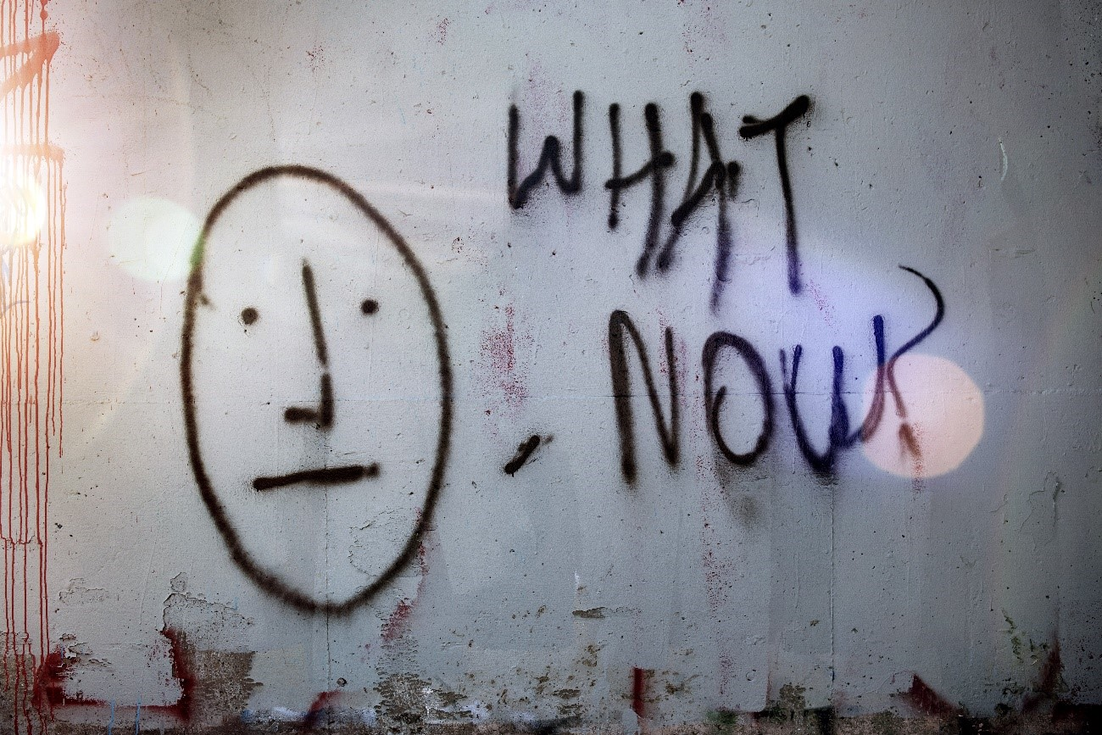
So many players…
Spoofers
Trolls
Troll armies
Influencers
Sock Puppets
Bots
Regular human beings…
Mossholder, T. (2020, May 5). What now? Unsplash. https://unsplash.com/photos/KZcWygxZ_J4 [Unsplash license].
Notes:
This is a veritable playground for those who want to create disinformation.
These are just some of the players involved – all of them are contributing to

Slide 13
Information Disorder
Notes:
Misinformation is incorrect but without ill intent – so a person posts about an upcoming storm from 2019, and everyone talks about it on FB for a while, but it doesn’t really harm anyone.
Disinformation – deliberate and intentional. Sophisticated headlines, news, stories, articles, scientific articles run by many players – bots, trolls, spoofers, influencers, governments, normal citizens – all as a weapon. WHY? To control, to make money. Pope Francis endorses Donald Trump in 2016. Very famous example.
Malinformation – information that is based on something real but is altered with intent to deceive or cause harm. Someone died after getting the covid vaccine – but in a car accident.
People have expressed a great deal of confusion about basic facts in the news and on the internet. Misinformation, disinformation and malinformation are three facets of Information Disorder that can help navigate falsehoods in the media and more effectively provide citizens with more meaningful vocabulary to address the concerns about the information they encounter.” aking something that is true, lying about it to fit your own narrative – very similar to propaganda – someone died after getting the covid vaccine – but they died in a car accident.
Wardle, C., & Derakhshan, H. (2018). Journalism, ‘fake news’ & disinformation: Handbook for journalism education and training. UNESCO. https://unesdoc.unesco.org/in/documentViewer.xhtml?v=2.1.196&id=p::usmarcdef_0000265552&file=/in/rest/annotationSVC/DownloadWatermarkedAttachment/attach_upload_b32bbe07-eead-4498-8d19-f4e32251a6d7%3F_%3D265552eng.pdf&locale=en&multi=true&ark=/ark:/48223/pf0000265552/PDF/265552eng.pdf#%5B%7B%22num%22%3A93%2C%22gen%22%3A0%7D%2C%7B%22name%22%3A%22XYZ%22%7D%2C16%2C812%2C0%5D [License:
A citizen’s guide to navigating information disorder, Political Science Senior Capstone, Colorado State University, 2021.

Slide 14
Many are disengaging with news and information as a result.
Notes:
Have you ever heard someone say, or have you yourself said: “I’m just so exhausted, I don’t want to talk about… insert divisive issue here ..Trump, covid, politics, vaccines. When we disengage, we make the troll armies, the creators of disinformation – those perpetuating the information wars successful.

Slide 15
Disinformation
Information that is false, the person who is disseminating (spreading) it knows it is false. It is a deliberate (done on purpose) lie, and involves people being actively disinformed by malicious (bad) people.
Fake news is a form of disinformation
Notes:
Why focus on disinformation? Most common and most dangerous right now., although malinformation is coming up quick. I would say that when considering navigating online resources for reliability, the most important thing to do is to think of these concepts as a spectrum – which they are, there is lots of overlap. However, identifying whether something is a harmless example of misinformation or a targeted action of disinformation might be helpful:
Misinformation – Moderna vaccine made me feel sick – oops I actually got Pfizer
Disinformation/malinformation – someone died of the vaccine but they died in a car accident. Sophisticated headlines, news, stories, articles, scientific articles run by many players – bots, trolls, spoofers, influencers, governments, normal citizens – all as a weapon. WHY? To control, to make money.

Slide 16
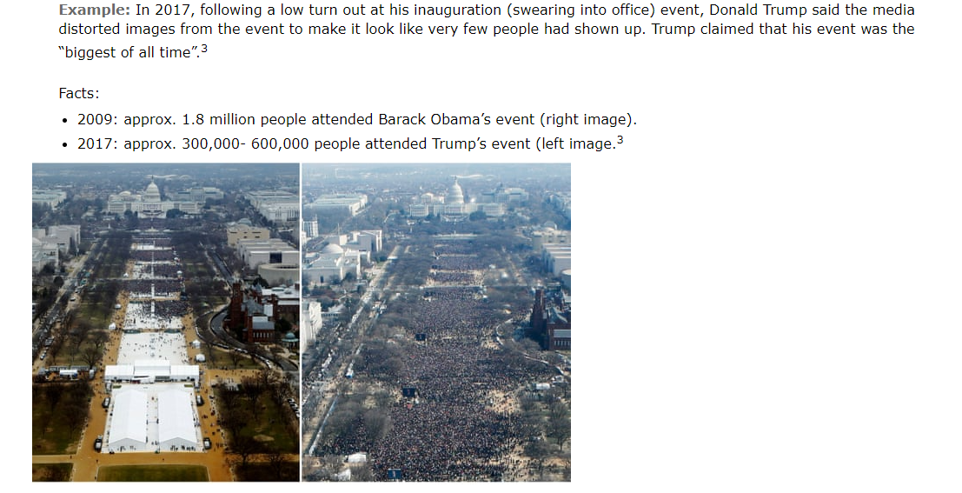
January 22, 2017
Trump calls the National Park Service, requesting that they edit the photos to make the crowd appear denser.
---crop here---
Notes:
Finnis, A. (2021). How many people were at Trump’s inauguration? How the bizarre row erupted the last time a President was sworn in. https://www.msn.com/en-gb/news/world/how-many-people-were-at-trumps-inauguration-how-the-bizarre-row-erupted-last-time-a-president-was-sworn-in/ar-BB1cTqFv
This can be either disinformation or malinformation – the important thing to note is that it is an attempt to deceive with a purpose. Trump wants to appear to be the most popular president voted in. He is always trying to outdo his predecessor – as we saw throughout this presidency. We also witnessed zero attempts to verify the information that came out of his mouth. When he said something, his base would generally accept it. This becomes a bigger problem overtime…

Slide 17
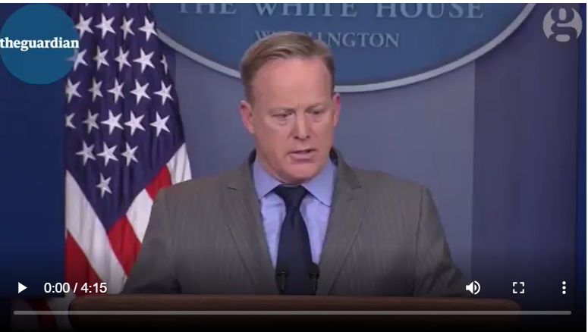
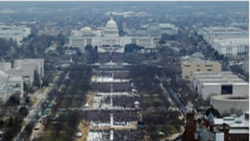
January 22, 2017
At a press conference Sean Spicer falsely states “This was the largest audience to ever witness an inauguration – period.”
Swaine, J. (2018). Trump Inauguration crowd photos were edited after he intervened. The Guardian. https://www.theguardian.com/world/2018/sep/06/donald-trump-inauguration-crowd-size-photos-edited

Slide 18
January 22, 2017
The administration begins to circulate this edited photo to prove this point.
Swaine, J. (2018). Trump Inauguration crowd photos were edited after he intervened. The Guardian. https://www.theguardian.com/world/2018/sep/06/donald-trump-inauguration-crowd-size-photos-edited
Notes:
The article that outlines the investigation done in which the national park service admitted that the photos had been edited was published over a year and a half later in September of 2018 – my question – could the damage be undone even if the report about the doctored photos, even if it was revealed immediately after?

Slide 19
Review
People are experiencing information overload.
People are becoming overwhelmed and disengaged.
Disinformation campaigns serve various financial and political purposes with countless perpetrators.
Many don’t recognize disinformation.

Slide 20
The Library
What is our role?

Slide 21
“Information professionals and librarians have positioned themselves at the front lines of the information war.”
(De Paor & Heravi, 2020, p. 5)

Slide 22
The library’s role
LIT professionals have long been considered traditional gatekeepers and fact-checkers of information.
Today they are shifting from fact checkers to educators.
Checklists and simple frameworks are no longer enough.
The issue cannot be stopped, but we can fight it with widespread literacy.
(De Paor & Heravi, 2020)

Slide 23
Information Literacy
Information Literacy:
“…an information literate individual should recognize when information is needed and have the ability to locate, evaluate and use effectively the needed information.”
(ALA, 1989).
Further:
“Information literacy is the ability to think critically and make balanced judgements about any information we find and use. It empowers us as citizens to reach and express informed views and to engage fully with society.”
(CILIP, 2018)
(De Paor & Heravi, 2020, p. 4)
Notes:
As you know info lit is the cornerstone of what we do.

Slide 24
Academic Libraries
Evaluation Framework, Fake News, and Fact Checking libguides
Harvard, Cornell, Penn State, Portland University, University College Dublin, Maynooth University Ireland.
“Fake News, Lies and Propaganda: How to Sort Fact from Fiction” – 2017 – University of Michigan (LibGuide)
Instructional Programs
“Calling Bullshit: Data Reasoning in a Digital World” – 2018 – University of Washington – originally 1 credit course, now a 3-credit course
Workshops
Cornell University – students get extra credit for attending.
(De Paor & Heravi, 2020, p. 5)

Slide 25
Public Libraries
Training course (8-week) in community journalism for high-school students
Dallas Public Library
Collaboration with local journalists to inform on good and bad journalism “Storytellers with Boarders”
Journalists explain how to ask focused questions; librarians show how to use databases to find reliable information.
Interactive workshops in and out of library
Staff travel to schools and organizations to help student discern real and fake news
Oakland Public Library
Use of the RADAR and CRAAP tests in sessions
(De Paor & Heravi, 2020, p. 5)

Slide 26
What about
Health Libraries
Special Libraries
Other

Slide 27
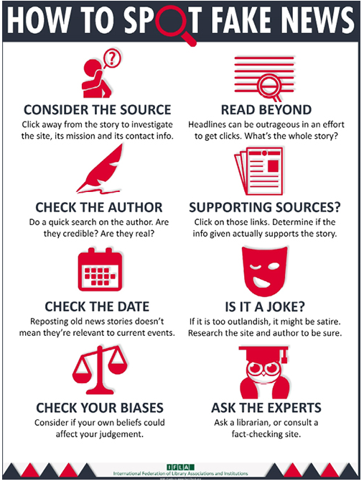
Libraries must advocate
American College & Research Libraries
International Federation of Library Associations and Institutions

Slide 28
Real Librarianship
Collection development
To provide access to current, reliable print and electronic news info across the political spectrum.
Programs & Instruction
To educate on critical thinking and lifelong learning.
Advocacy
Inform decision makers - legislators, policy makers, business leaders and citizens must be aware of the library’s vital role in this fight.
(De Paor & Heravi, 2020, p. 6)

Slide 29
The Project
Notes:
Knowing everything that we know, and understanding that the library is perfectly positioned to develop the tools, me and a colleague applied for funding and developed a mini course in the summer of 2021.

Slide 30
“I don’t like to read news articles, I only read the comments sections. This information seems truer to me.”
- Postsecondary student, 2020.
Notes:
At that exact moment, that I understood, what I was doing – a one-shot session teaching an evaluation framework would never be enough.

Slide 31
Funding to create an open education course
Dec 2020
Applied to create open mini-course
Jul-Dec 2021
Course creation, testing, modifications.
Communication to interested programs.
Apr 2022
All iterations of course complete, piloted with Sask Polytech program.

Slide 32
We have created
Mini course (in our LMS)
Staff version
Student version
Open Course
Open Textbook (still to come…)

Slide 33
Goals of Creation
Develop:
An instructional program that provides deeper learning related to:
information literacy, digital literacy, media literacy, critical thinking.
A course that can be used by faculty in various ways:
Retain, Revise, Remix, Reuse, Redistribute
A course learners can complete with or without library intervention/involvement.
Notes:
Even if an instructor “doesn’t have time for a librarian” it is still a possibility that students can take it.

Slide 34
The course
Self-register.
Self-paced, 2-4 hours long.
Instructor options:
Have student enroll and complete course independently.
Have students enroll and complete course
Invite a librarian to support learning (multiple options).
Pull any learning materials from the course to utilize in their course.
Pull modules from the LMS and insert them directly into their course.

Slide 35
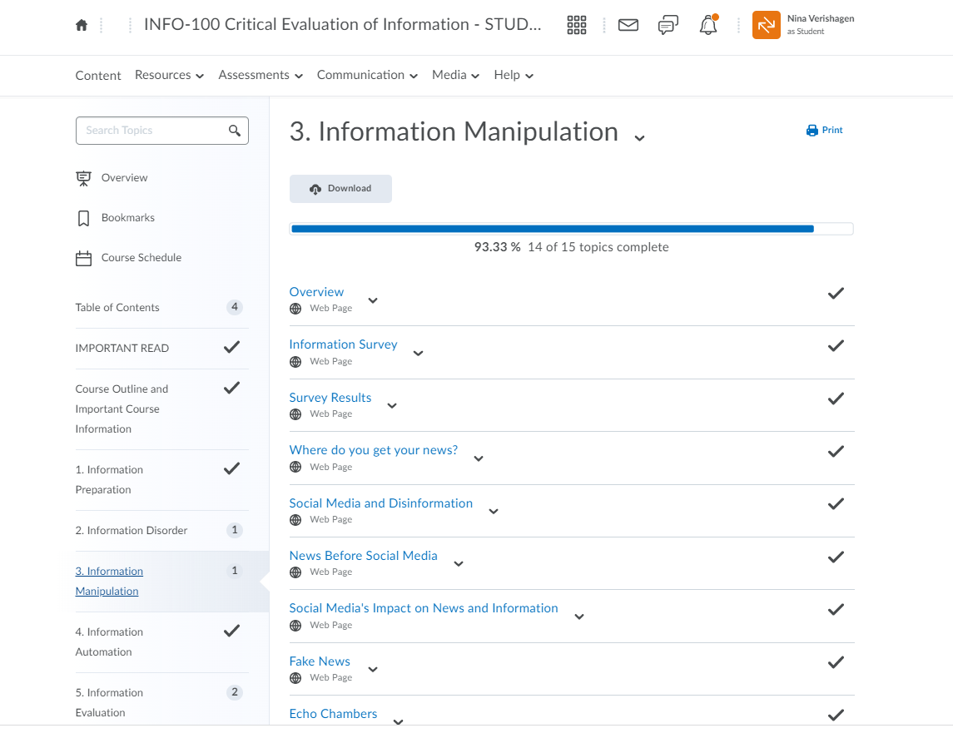
Internal Version

Slide 36
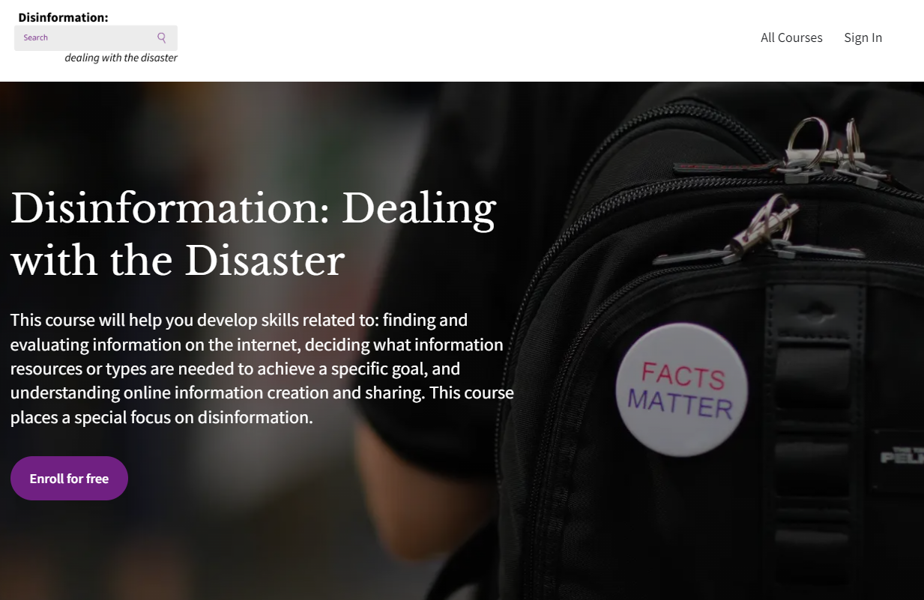
Open version
Notes:
https://disinformation-s-school.thinkific.com/courses/disinformation

Slide 37
Deeper learning
Information Literacy
“Information literacy is the ability to think critically and make balanced judgements about any information we find and use. It empowers us as citizens to reach and express informed views and to engage fully with society” (CILIP, 2018).
Digital Literacy
“the interest, attitude and ability of individuals to use digital technology and communication tools appropriately to access, manage, integrate, analyze, evaluate information, construct new knowledge, and to create and communicate with others” (Government of BC, n.d.).
Media Literacy
“Develop critical thinking skills around all types of media; build an understanding of how media messages shape our culture and society; give people tools to advocate for changed media systems” (Media Literacy Now, (n.d.).
Notes:
Characteristics in BC’s Framework include – research and information literacy, critical thinking, problem solving and decision making, creativity and innovation, digital citizenship, communication and collaboration – all intended to be instilled in learnings as they navigate the K-12 system.

Slide 38
All versions cover
Information Preparation
Information Disorder
Information Manipulation
Information Automation
Information Evaluation
Notes:
Information prep – flipped classroom – have students evaluate information before they get into the course.
Info Disorder – a look at the info environment, how much is out there, concepts of information overload, information disorder etc.
Info Manip – the human side – focus on news production, social media, influencers, etc.
Info auto – robotic side of info disorder – algorithms, search engines, etc.
Info evaluation – presents 3 frameworks for analysing info – increase in intensity – checklist, lateral reading, journalistic approach. Throughout the course we present 4 frameworks to evaluate information – hoping that upon completion the learner will take one with them, or remember one.

Slide 39
Enrolled so far:
December 2021
Library staff, faculty from focus groups
April 2022
Student cohort – LIT program
April 2022
Faculty more widely

Slide 40
The Response
Notes:
We were shocked – at the beginning of our project we held focus groups with instructors asking them things like – how long of a course on this topic would you require your students to do, what topics do you think are most important, can you fit this into your learning outcomes and your cirriculum. All resoundingly yes. In fact, for our pilot study this Spring we had the option of three programs to choose from, as a number of faculty were eager to put their students through it.

Slide 41
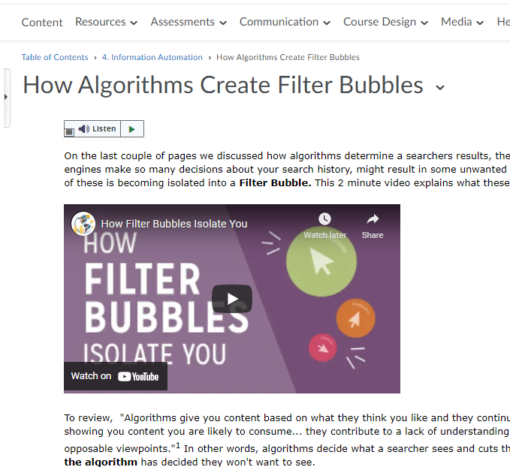
Response of INFO 100 (internal course)
Faculty/Staff version
51 enrolled;
38 requested independently
Instructors audit to incorporate materials or entire course into their class.
3 instructors have requested student version for Fall 2022.

Slide 42
Faculty PD Session
19 live attendees; 62 views (as of TODAYS DATE)
Tons of conversation
A surprising amount of interest
Notes:
Well attended PD session
All participants asked to be enrolled in the course

Slide 43
Pilot in April with Library and Information Diploma Students.
19 students completed entire course.
The course was used for a credit component of Lib 193: Current Trends in Libraries - fulfilled a learning outcome (20-mark assignment).
Extremely positive experience.
Student Response
Notes:
Our project was always going to have a pilot. We are currently collecting data from this work. Nina visited class and taught for a few hours, the students did the entire course and handed a marked assignment into their instructor.

Slide 44
Student Quotes
"Ever since I learned about filter bubbles, ...I've been going out of my way to attempt to look and search for multiple sides of issues."
"I have learned that I cannot take everything posted on social media as true."
"On a personal level the definitions of misinformation, disinformation and mal information will be useful when describing the difference if it comes up in conversation."
"I will also be telling family and friends about The Great Moon Hoax because it is very silly and works as a fantastic example of how long disinformation has been around and how it can captivate people even when we seem to think they know better.

Slide 45
Exemplar of Improvement
First Discussion
Final Assignment (Partial)
What is its purpose? To show how many bodies have been found at residential school sites across the country
Who created it? Laura Ulrich
When was the information created? July 2021, but had to go to the facebook page to find.
Where do the key points come from? Wikipedia
Why was it created? To raise awareness of the atrocities being found and how drastic it might be.
What What type of source are you looking at? What is the purpose of that type of resource? | A personal blog, that is aiming to sell e-cigarette and nicotine products
Who Who is the creator? What is their relationship to the subject matter? Who is facilitating the publication of this resource? | James is a co-author of a study on e-cigarettes? What is a co-author? Author does not equal expert. E-Cigarette company in the UK publishes the “ashtray blog” and most of the links are to their products.
When When was the resource created or last updated? | Last updated in 2012, based on comments. Other posts within the blog are more recent, but are primarily sales pitches.
Where Where (geographically) was the resource created? Why is this important? | Doesn’t say or show location. Uses British Slang and primarily listed for ecigarettedirect.co.uk, but author is labelled as University of Alberta author.
Why Why was it created? What has motivated the creator to publish this resource? | To convince people to smoke, and the benefits of nicotine. Because of the attachment to the company, likely to also sell products connected to the website.
Notes:
Note the level of evaluation on the WHO – the student questioning the author of the second source much more critically.

Slide 46
Requests for Open Version
Numerous requests for this version – in our personal, professional and Sask Polytech networks.
1 request to include the link in a micro-credential,
Recovering from the Pandemic in Early Childhood Education
and offer to include it in many more

Slide 47
Moving Forward

Slide 48
Open textbook
Slated to be completed December 31, 2022.
Pilot project data collection and analysis.
Course edits and improvements.

Slide 49
Saskatchewan Polytechnic Library
Using what we’ve created the library will position itself to offer multi-literacy instruction on this very important issue throughout the organization.
There is need, there is interest, there will be uptake.
Information literacy, media literacy, digital literacy, meta-literacy, lifelong learning, critical thinking.
We’ve created the tools, now it’s time to use them.

Slide 50
nina.verishagen@saskpolytech.ca

