Slide 1
The Needs of the Many …
Saskatchewan Health Authority Library
May 3, 2019
Saskatchewan Library Association 2019 Conference

Slide 2
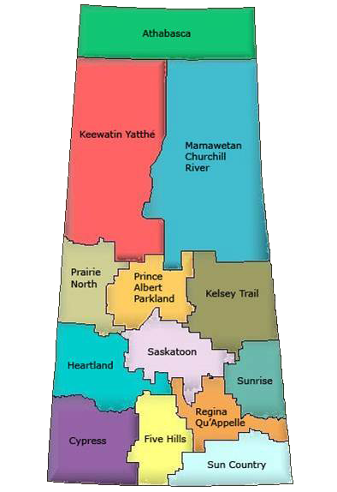
Outweigh the needs of the few …

Slide 3
Or the one …
CIF December 4, 2017

Slide 4
SHA Library
7 physical libraries (soon to be 8) in three cities
5 librarians; 2 librarian supervisors
4.8 library technicians
1 Transition leader
Main library is virtual – the website

Slide 5
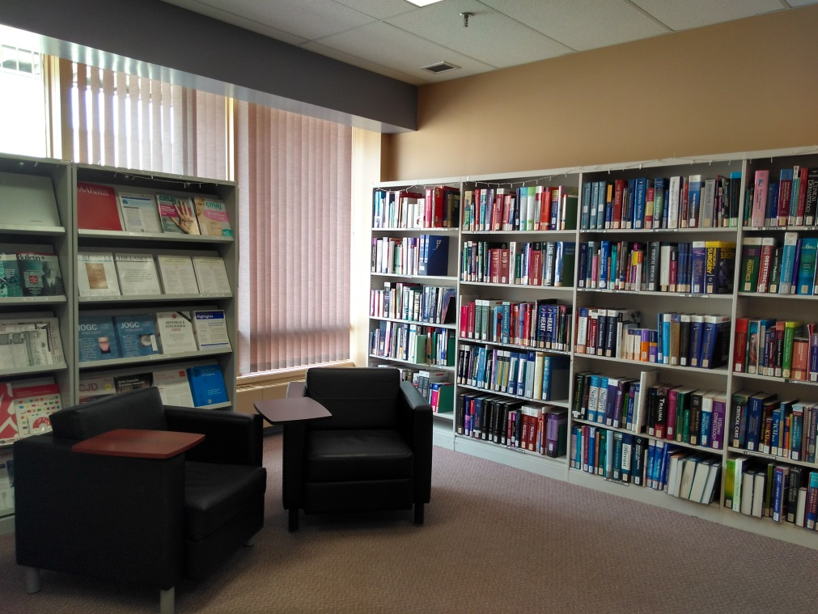
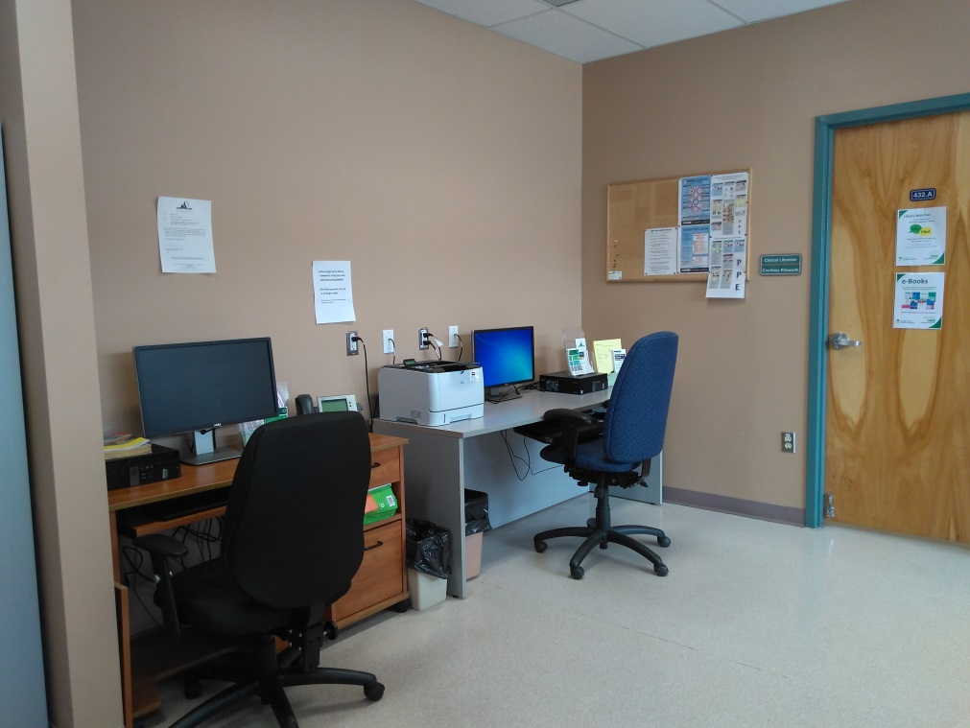
Victoria Hospital, Prince Albert

Slide 6
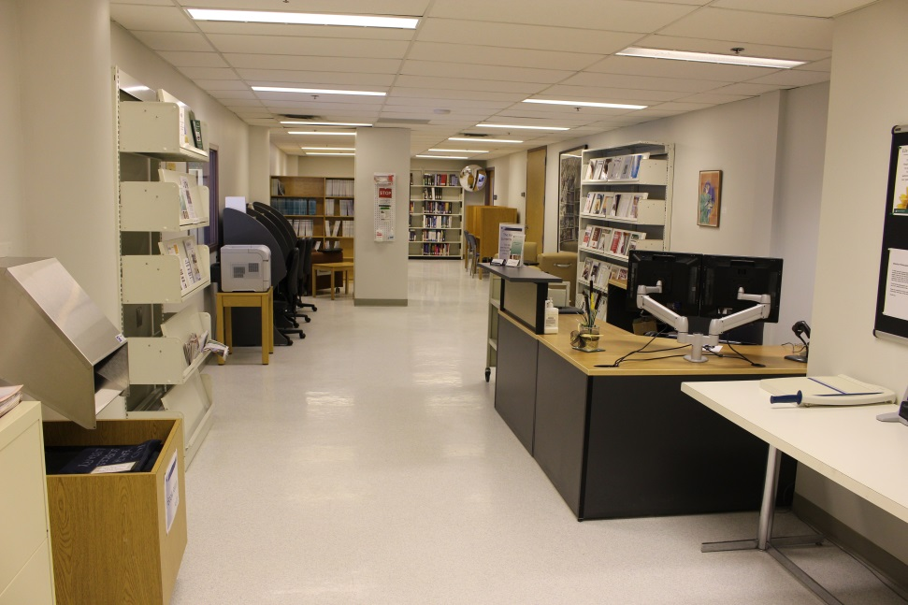
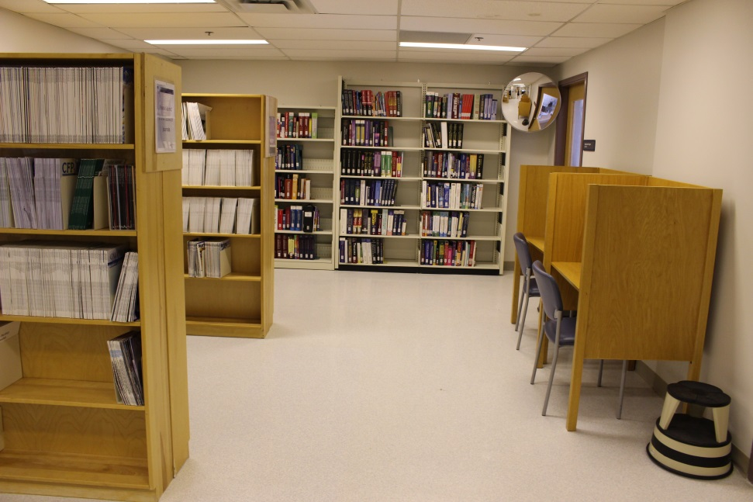
Pasqua Hospital, Regina

Slide 7
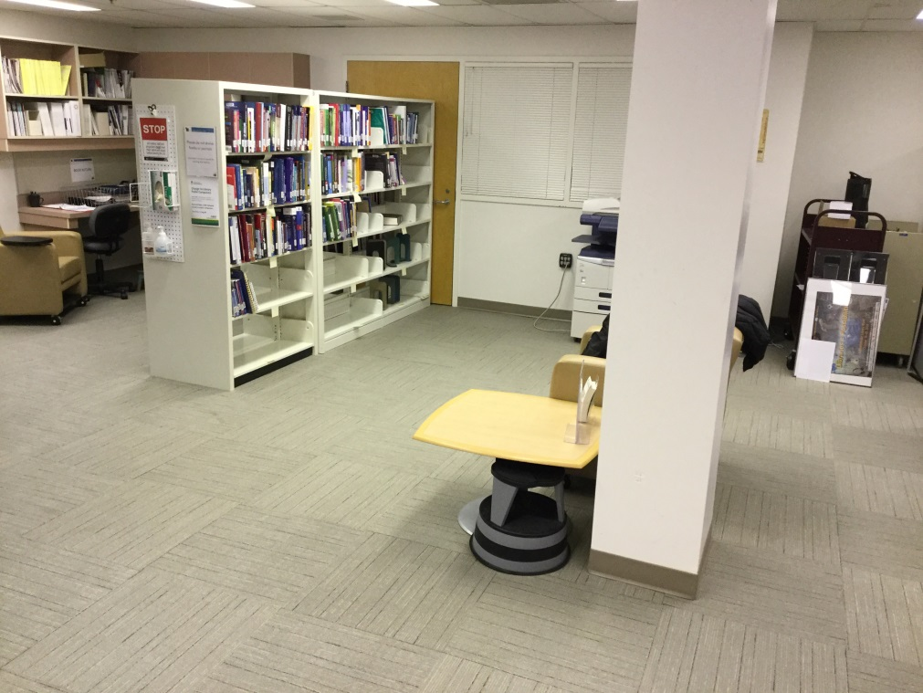
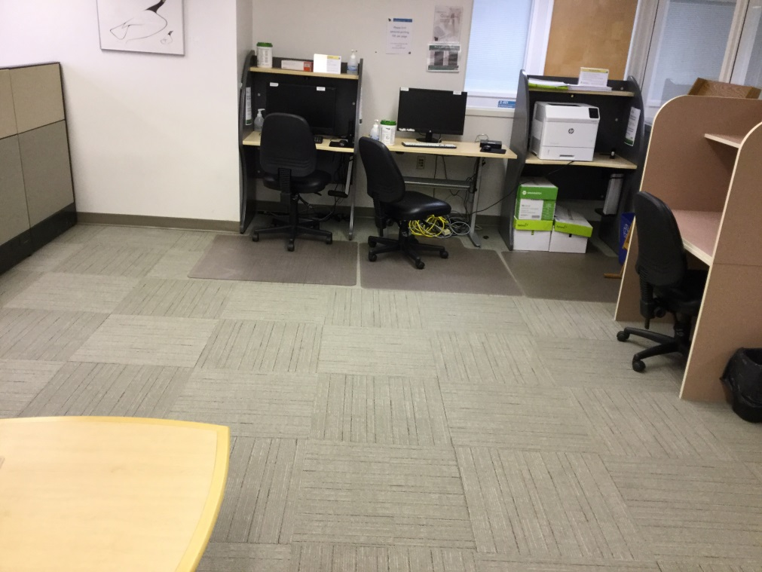
Wascana Rehabilitation Centre, Regina

Slide 8
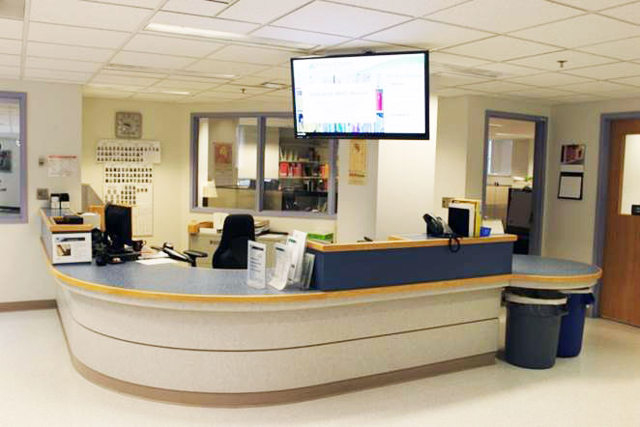
Regina General Hospital

Slide 9
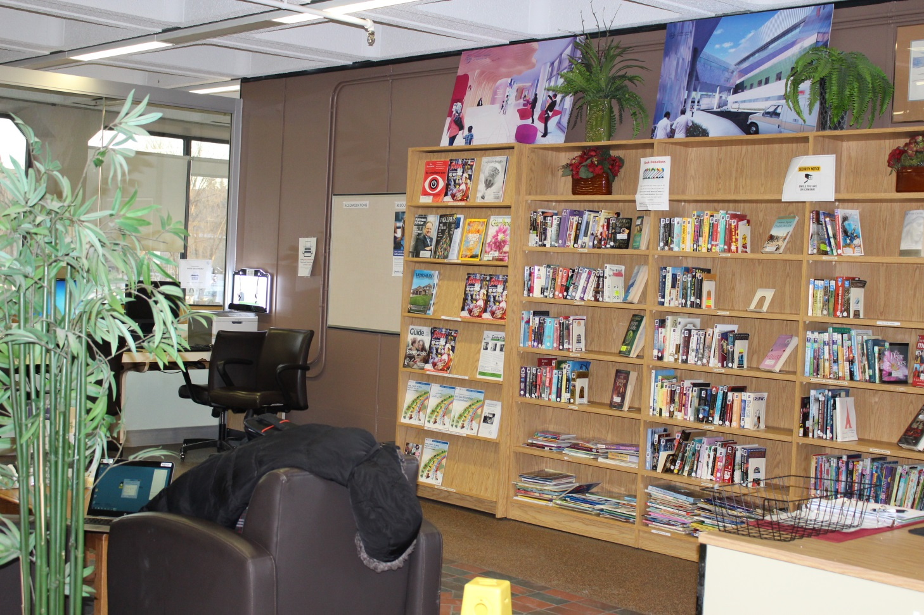
Royal University Hospital, Saskatoon

Slide 10
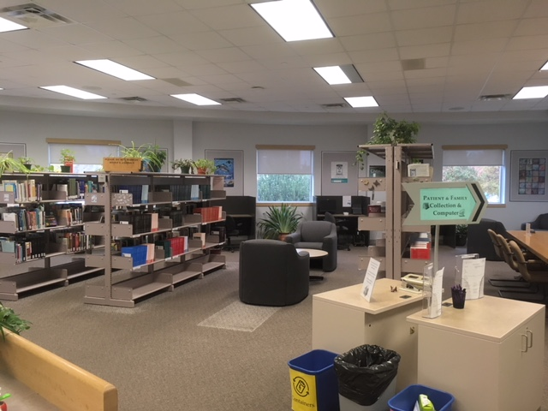
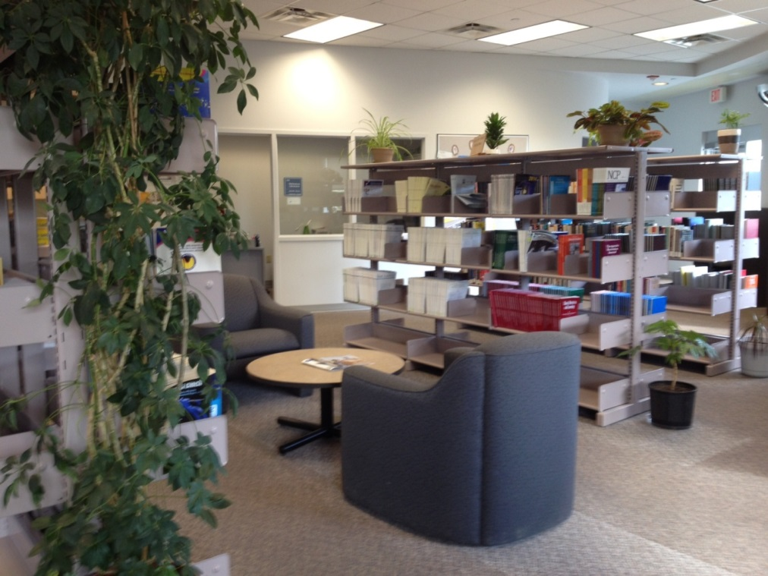
City Hospital, Saskatoon

Slide 11
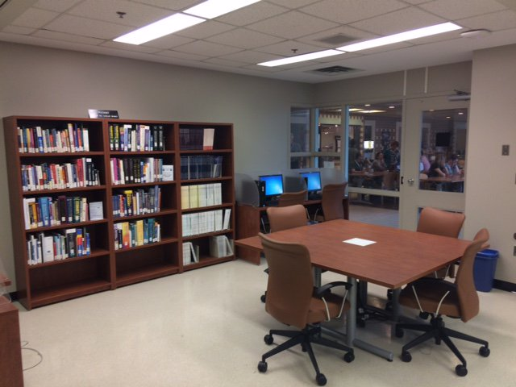
St. Paul’s Hospital, Saskatoon

Slide 12
Library Services

Slide 13
Library Services
Evidence (literature) searches
Document delivery/ILL
Mobile apps
Patient education sessions
Attending rounds & liaison area meetings
Citation and Copyright advice
Teaching and library instruction

Slide 14
How did we get here?
History for context
Overview of the transition work
What’s around the corner

Slide 15
12 Regions – 3 libraries + SHIRP

Slide 16
“Think & Act as One”

Slide 17
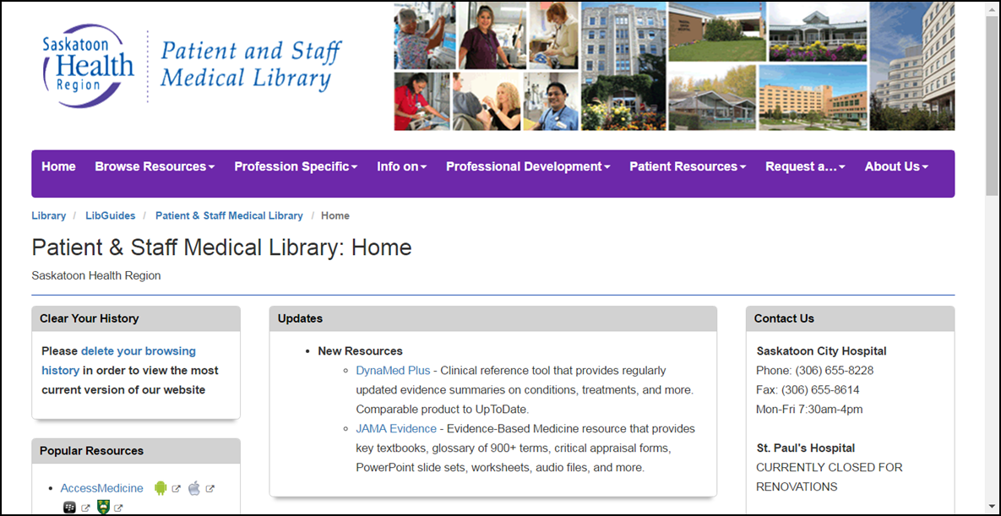
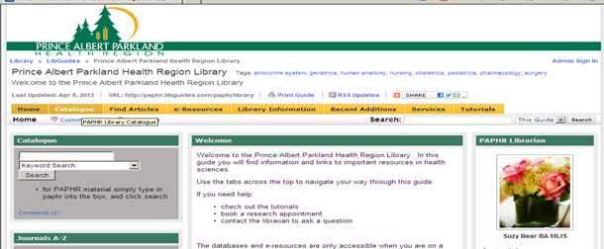
Three Websites

Slide 18
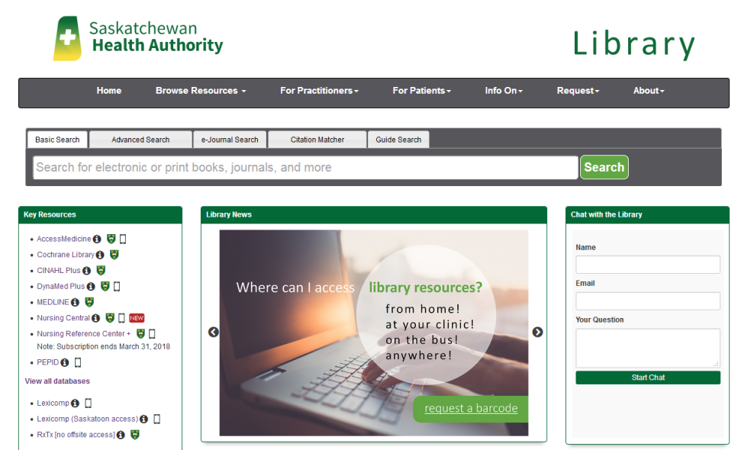
SHA Library Website
http://saskhealthauthority.libguides.com

Slide 19
Lead Areas
Website
Evidence searching → Reference Service
Library instruction
Mobile resources
Marketing
Professional Development

Slide 20
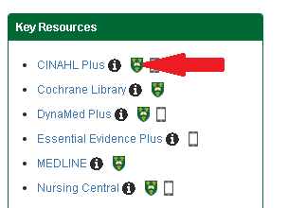
Standardizing the Collection
SHIRP collection was integral
Converting regional to provincial
3sHealth → Provincial RFP serials
MDLP → SHR/RQHR to provincial

Slide 21
Instant Growth
Region | Staff | Physicians
Regina Qu’Appelle | 7,956 | 745
Saskatoon | 14,268 | 1,130
Prince Albert Parkland | 2,040 | 146
TOTAL 3 REGIONS | 24,264 | 2021
SHA | 44,000 | 2378

Slide 22
Related Organizations

Slide 23
Challenges
Being provincial before anyone else
IT challenges : IPs, email, understanding
Communications – THE key to success
Procurement – library ordering
Changing roles, positions, people
Contacting people across SHA

Slide 24
The Future
Accessibility of Policies: SHA & former
Integration into LMS & AIMS
Partnership with HealthLine
Stronger connection with Patient & Family Centred Care
Library organizational chart
Copyright permissions with Communications

Slide 25
SHA Library
Live Chat: Available M-Th 9:00 a.m. to 4:00 p.m.
Email: library@saskhealthauthority.ca
Phone:
-Regina: | 306-766-4142
-Saskatoon: | 306-655-5224
-Prince Albert: | 306-765-6026

Slide 26
Acknowledgments & Thank you!
Saskatoon | Catherine Young | Brianna Howell-Spooner
 | Colleen Haichert
PA | Courtney Ellsworth
Regina | Michelle Dalidowicz | Lukas Miller
 | Lance Fox | Martina Hahnefeld
 | Kathy Kreklewich | Lily Walter-Smith
 | Scott Frick
Former | Caroline Monnin | Catherine Hana
 | Suzy Bear | Amy Weisgarber

