Slide 1
Social Media
at the academic library
Nina Verishagen, Marketing Librarian, Saskatchewan Polytechnic
Notes:
Introduction

Slide 2
My book
A practical guide for alllibrarians.
Contributing authors are librarians engaged with social media.
Part I: The Social Media Landscape at the Academic Library
Part II: Tried and Tested by Librarians: Social Media Case Studies
Instagram
Twitter
Facebook
YouTube
SnapChat
Pinterest

Slide 3
My chapters
Co-Author
Chapter 2:
Social Media Committees: Sharing the Libraries Voice
- Co-author Alejandra Nann, Copley Library, University of San Diego
Chapter 8 (Facebook chapter), case study 2:
Buying Likes: How Our Library Jumped From 200 to 1000 (Student) Likes in 5 Months
- Co-author – Ann Liang, Saskatchewan Polytechnic Library

Slide 4
Social Media
Canadian Trends: Academic Libraries
At Saskatchewan Polytechnic
Facebook
Instagram
Twitter
Notes:
Introduction

Slide 5
Facebook
Adoption in Canada
95% of 18-24 year olds (post-Millenials)
94 % of 25-34 year olds (Millenials)
Grudz, Jacobson, Mai, Dubois, 2018 – Ryerson University Social Media Lab Report
At Saskatchewan Polytechnic
2013 – 609/708 (86%) students FB is the only platform they use;
2016 – 48/62 (77%) students and faculty actively use FB.
In 2016 - we decided to direct our efforts to this platform, we still do.
Notes:
Ryerson University survey of 1500 Canadians. Done in 2018.

Slide 6
Facebook likes since August 2016
315 followers before we began our efforts

Slide 7
What did we do? (Chapter 8, cs2)
Make a plan.
Ours involved contests.
Get the likes, keep the likes.
Went from 300-1000+ (student) likes in 5 months;
Experienced successes and failures.

Slide 8
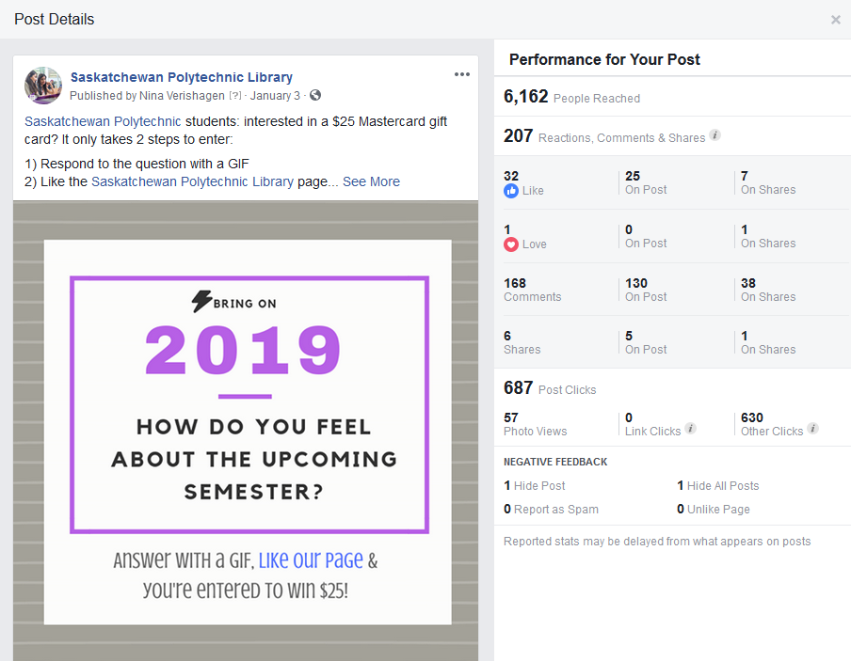
Two types of contests
Gain likes
Engage with current followers

Slide 9
Facebook Likes: Current Academic Year
Up 1498
Majority of followers are our students.
Focus, focus, focus.

Slide 10
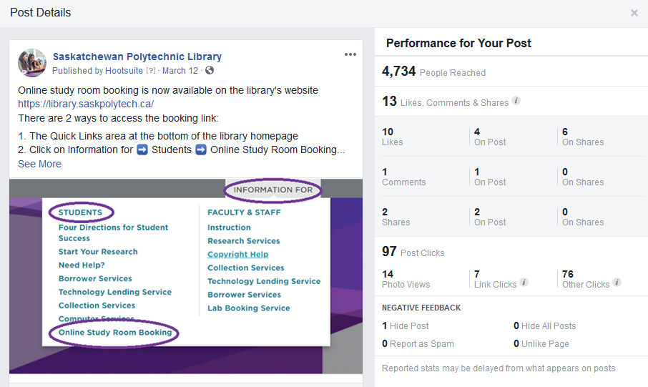
Establish Engagement – Then Engage!
Post informing students about our new online study room booking;
Reached 4,734 people
A very high performing post.

Slide 11
Instagram (coming in hot…)
Instagram in Canada
67% (18-24 year olds) = heavy users
62% (25-34 year olds) = recently adopted
(Grudz, Jacobson, Mai, Dubois, 2018).
Case studies (out of US Academic Libraries) reflect the trend that young people are shifting to Instagram.
Libraries are using Instagram (rather than other platforms) to connect with students for various reasons.
Notes:
Various reasons – student workers tell them to; high percentage of younger generations adopting and using Instagram as their main social channel; vast majority of students following any library account choose Instagram.
Green – we weren’t doing much of anything to engage – blue – we started to focus on Instagram as a chief platform to connect with students.

Slide 13
Building our following
September 2018 | 156
October 2018 | 494
May 2019 | 556

Slide 14
Twitter
Twitter in Canada
Adoption rates high amongst high income earners (46%) and the highly education (33%)
(Grudz, Jacobson, Mai, Dubois, 2018).
Twitter at Sask Polytech Library
Students – not a good target audience.
New target audience Faculty/Staff
Notes:
High income – more than $120,000
Highly educated – doctorate level
Identifiable Student followers – 3
Identifiable Staff/Faculty followers – 49 – since we changed our goals and targets we have 59 identifiable staff members, an increase of 10.
Also enables us to focus on the things that academics and researchers like to use Twitter for – re

Slide 15
Our new Twitter direction:
Educators use Twitter for:
Research
Professional Development
Sharing and buildingnetworks
Career Advancement
(Atkins, Koroluk, Stranach, 2017)
https://twitter.com/saskpolytechlib?lang=en

Slide 16
Social Media Committees (SMCs)
The Secret to Sask Polytech Library’s Success
Social Media is not a one person job.
Represent various staff and personalities.
We are geographically distant.
Creativity is key to success.
Notes:
Introduction

Slide 17
Tips for any social media committee
Harness and Share Your Library’s Voice
The User or Target Informs All Things
Not all platforms are worth your time
Remain Up-to-date on social media trends
Meet Regularly
Be Flexible
Use Analytics

Slide 18
Tips for any social media committee
Harness and Share Your Library’s Voice
Although the committee’s functions include technical and workflow aspects, it’s the main reason for existence is to develop and share your library’s voice.
Ensure membership is representative of your library’s workforce.

Slide 19
Social Media Committees – The Library’s Voice
The library’s voice is your voice! Be professional, but also be authentic “the unique way we think and how we say things helps us come across as authentic, which makes us seem ‘more human’ online” (King, 2012, p. 6). Don’t turn your online interactions into institutional speak, leave in the quirks and personality.
Sask Polytech Library Social Media Committee Guidelines
Notes:
Committee members are in from various departments, and locations at Sask Polytech library. Includes librarians and technicians and in the past Clerks. Would be even stronger if we could get students on committee – something I'd like to see in the future.

Slide 20
Tips for any social media committee
2. The User's Perspective Informs All Things
Not all platforms are worth your time
Assess your audience – formal or informal
Pull data and use it!
Choose your platform based on your user.
Remain Up-to-Date on Specific Platforms
Keep track of new features and functionality.
Discuss changes with your SMC and make plans to deal with changes.
Keeps abreast of social media trends.
Notes:
Touched on this a bit earlier when discussing Twitter. We when we realized that Twitter was not working for us to target students, we decided to change our focus. It might become the situation that we decide to ditch Twitter depending on how things go. We've learned that it is essential to execute our work based on target audience and platform. This is one way we do things from the user perspective

Slide 21
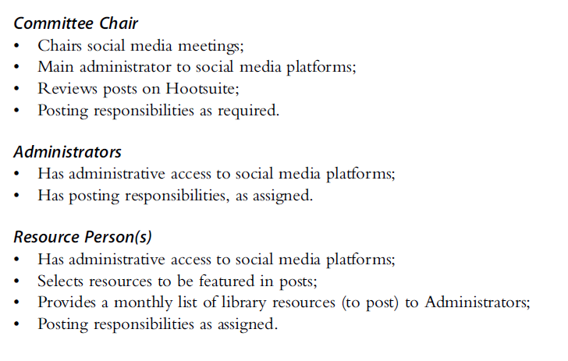
The Committee –2015-2018
Adapt based on user perspective

Slide 22
The Committee – 2018/2019
Committee Chair
Chairs meetings, assigns work, bird's eye view of all things social media
Facebook/Instagram lead
2 members lead based on their talents and expressed interest, target audience: Students
Twitter lead
1 members lead, target audience: Faculty/Staff
Other electronic communications lead
library website announcement, institutional digital signage, internal staff and student portal, newsletters, etc., etc.
Campus Contact
Provides insights into activities at their campus.

Slide 23
Tips for any social media committee
3. Meet Regularly
Schedule regular meetings with your committee members to keep up-to-date with different departments, or library locations. Regular meetings also ensure forum for discussion and brainstorming.
A standard meeting agenda is a good way to sustain the committee.

Slide 24
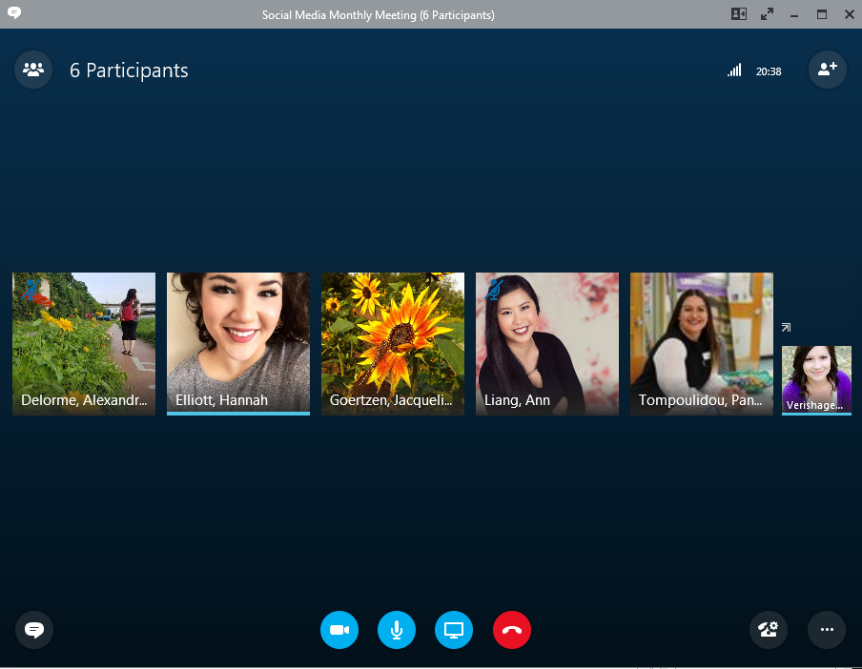
Sask Polytech Library’s SMC
We meet monthly online
Skype for Business Meetings
Chair sends an assignment email post meeting

Slide 25
Monthly Meeting: Standing agenda
Successes and Loose ends from the previous month;
Post ideas for the following month;
Post Assignments;
Additional Misc. Items
Workflow allows for one month of preparation. When we meet in January, posts for January have already been planned and scheduled, we are meeting to discuss February’s content and assignments.

Slide 26
Workflow: Scheduling Posts
Hootesuite
Helps us schedule posts during busy times of year (February example)
Enables us to release posts during off times: evenings, weekends, and holidays;
Allows us to easily curate and access other social accounts
It’s not perfect, but it helps us manage our work.
Some platforms offer scheduling software (Facebook), but some do not (Twitter).

Slide 27
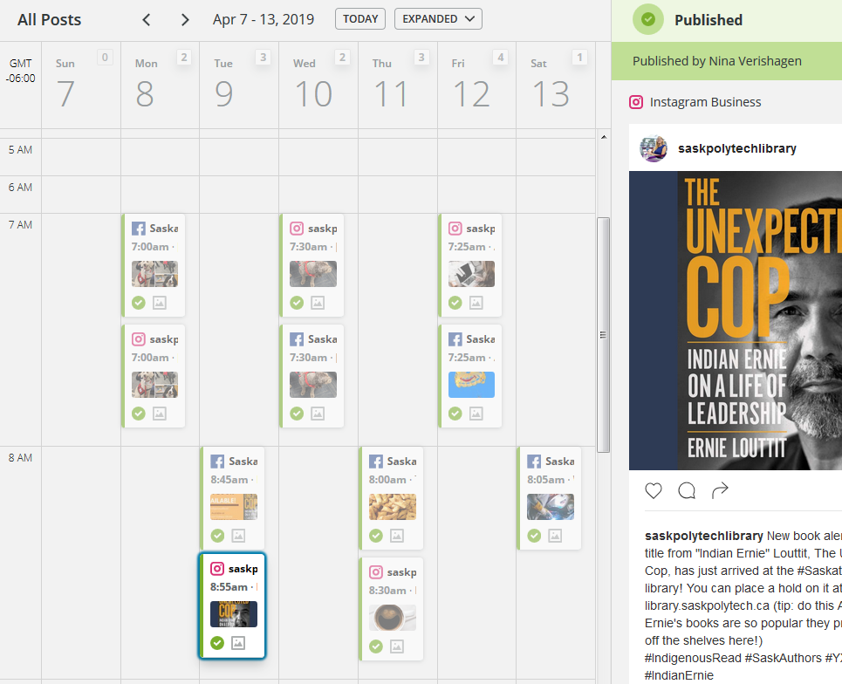

Slide 28
Tips for any social media committee
4. Be Flexible
Be mindful that every member has a full-time job aside from their committee responsibility, be flexible with work assignments.
Have conversations.
Discuss successes and failures.
Notes:
Additionally, this flexibility extends into all aspects of social media. Understand that even if Facebook is your favorite platform, it might not be your target audiences favorite, so you might have to ditch it from one year to the next. It's essential that you expect changes and are prepared to incorporate them into your workflow as necessary. Although some changes need to be made more regularly, I make it a point to have our committee meet to discuss the past year, and the upcoming year each Spring.

Slide 29
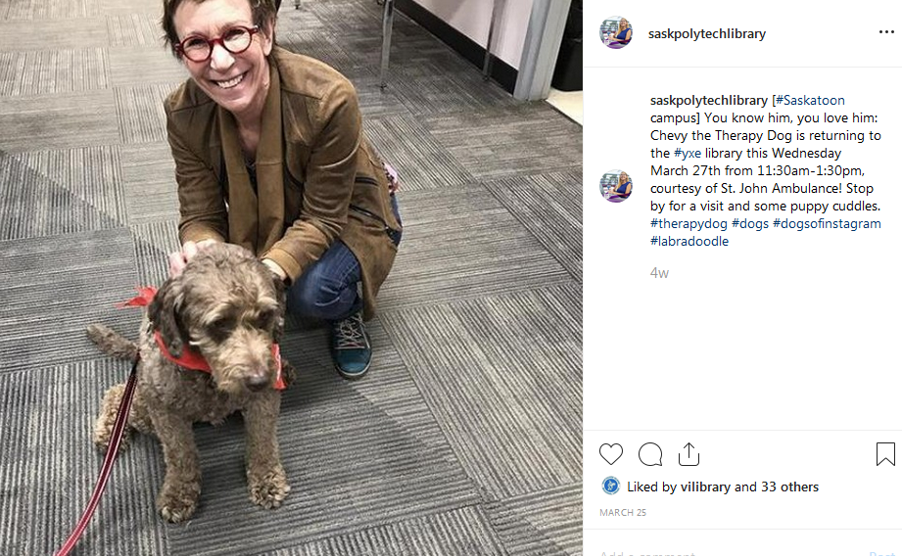
Have conversations
Most popular Instagram Posts this year (other than a contest)
“Why are dog pictures ALWAYS our highest performers?”

Slide 30
Tips for any social media committee
Use Analytics
Analytics provide invaluable information about your followers such as when they are viewing or engaging with your posts. Use this information to inform your plans and schedules.

Slide 31
What worked? What didn’t?
Facebook Contest
Massive Success
Reached over 6000
168 Students Commented
Instagram Contest
Massive failure
15 likes
4 student comments
Failure
Success
Was it the platform? Type of contest? The question itself? The prize?

Slide 32
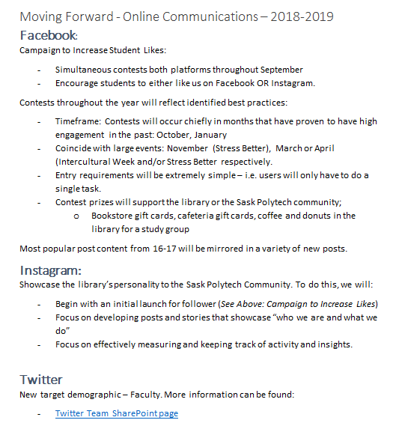
Use all of this to move forward

Slide 33
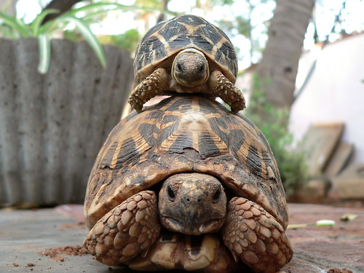
Relationship with Organization
HOT TIP:
Maintain a close relationship with your parent organization.
Sask Polytech Accounts
Facebook – 33,000 likes
Twitter – 8,000 followers
Instagram – 3,800 followers
Notes:
Include screenshots of examples from Facebook

Slide 34
Thank for listening
Nina Verishagen
nina.verishagen@saskpolytech.ca
@librarynina

Slide 35
References
Atkins, B., Koroluk, J., & Stranach, M. (2017). Canadian teaching and learning centres on Facebook and Twitter: An exploration through social media. TechTrends: Linking Research & Practice to Improve Learning, 61(3), 253–262. https://doi.org/10.1007/s11528-016-0144-2
Gruzd, A., Jacobson, J., Mai, P., Dubois, E., (2018). "The State of Social Media in Canada 2017", https://doi.org/10.5683/SP/AL8Z6R

