Slide 1
Accessible Library Service 101 and Early Literacy Strategies for Children with Print Disabilities

Slide 2
Introductions and where are we coming from?
Riane Lapaire, Saskatchewan Alternate Format Materials Library/Braille Production Coordinator, National Network for Equitable Library Service (NNELS), lapairer@spsd.sk.ca ; braille@nnels.ca
Lindsay Tyler, Senior Manager, Centre for Equitable Library Access, lindsay.tyler@celalibrary.ca
Show of hands: What type of library do you work for? Are you working in a rural or urban setting?

Slide 3
What is a print disability?
A print disability is a learning, physical or visual disability that makes it difficult or impossible to read conventional print.
Defined by Canadian Copyright Act Section 32
Print disabilities can be temporary, for example, injury affecting hands.
Disability must affect specifically the ability to read print; by changing the format alone, you make the content accessible. For example, English-language learner status on its own is not a print disability.

Slide 4
Print disabilities and access to reading
Approximately 10% of the Canadian population has a print disability
Less than 10% of materials published are available in a format accessible to people with print disabilities
Public library staff and educators play key role in ensuring access to accessible materials and advocating to close the gap

Slide 5
What’s available to residents of Saskatchewan with print disabilities?
Books in accessible formats offered through public libraries and schools
Audio, braille and accessible ebooks
Materials for all ages and interests
3 complementary services: Saskatchewan Alternate Format Materials Library serves schools; CELA and NNELS support public libraries

Slide 6
SAFM Library Collection and Services
The Saskatchewan Alternate Format Materials (SAFM) Library is a provincial lending library for preK-12 students with perceptual disabilities.
They lend curricular titles, textbooks, free-reading, professional, and tactile learning materials in braille, large print, etext, and audio in both English and French.
Students are registered for services by their assigned TSVI (Teacher of Students with Visual Impairments) or other designated Special Education/Resource Teacher/Consultant.
The SAFM Library is part of a group of provincial resources centres across Canada called CAER (Canadian Association of Educational Resource Centres for Alternate Materials) www.caercanada.ca

Slide 7
CELA services offered through SK public libraries
Collections and services
Access to 700,000 titles in audio, braille or accessible ebooks, magazines, newspapers, in CELA and Bookshare collections
Delivery options include library or home delivery of physical materials, or download to DAISY player, app or computer
French and English, plus some other languages
Award winners, best sellers, materials for all ages
Sign up
Register at public library or online at signup.celalibrary.ca

Slide 8
NNELS services offered through SK public libraries
Access to over 40,250 titles published titles in DAISY, MP3, etext, EPUB, PDF, BRF, and braille formats.
Books in NNELS are available in English and French. Priorities for collection development are books in Indigenous and international languages.
Registration for Services
Saskatchewan residents with a print disability designation can use their library card to sign in (https://nnels.ca/organizations/search) to access the titles available through NNELS. The print disability designation can be acquired through the patron’s home public library branch.
Public Library Staff can see https://mlb.libguides.com/printdisabilities for more details.

Slide 9
Tools and demos: Mobile devices and accessible reading apps
Most popular accessible reading apps are Dolphin EasyReader and VoiceDream Reader; both available on iOS and Android
Pros and cons to each app
Both support DAISY audio and text, epub
Both fully accessible and compatible with screen readers and braille displays
Dolphin EasyReader supports CELA Direct to Player service & automatic selection service

Slide 10
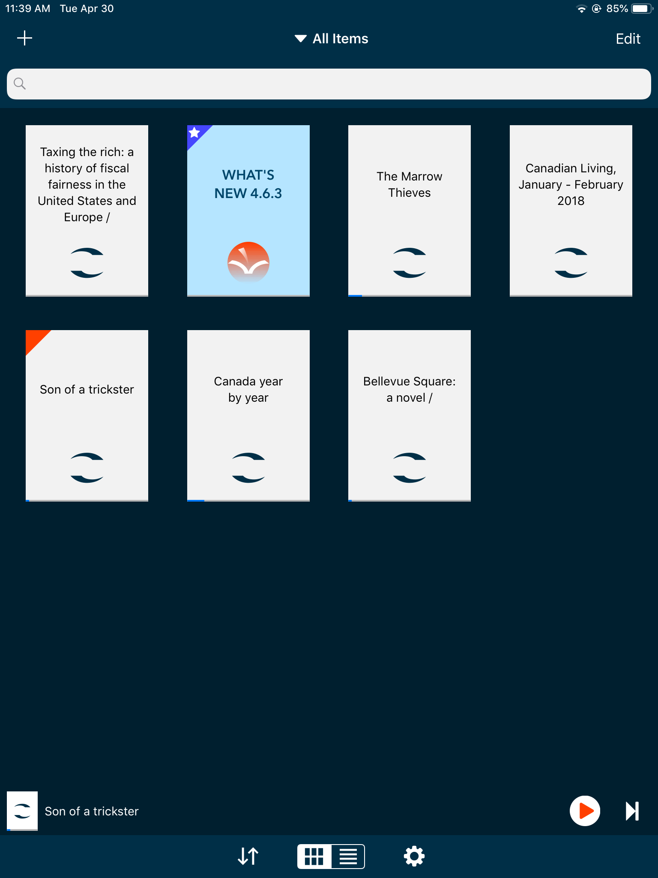
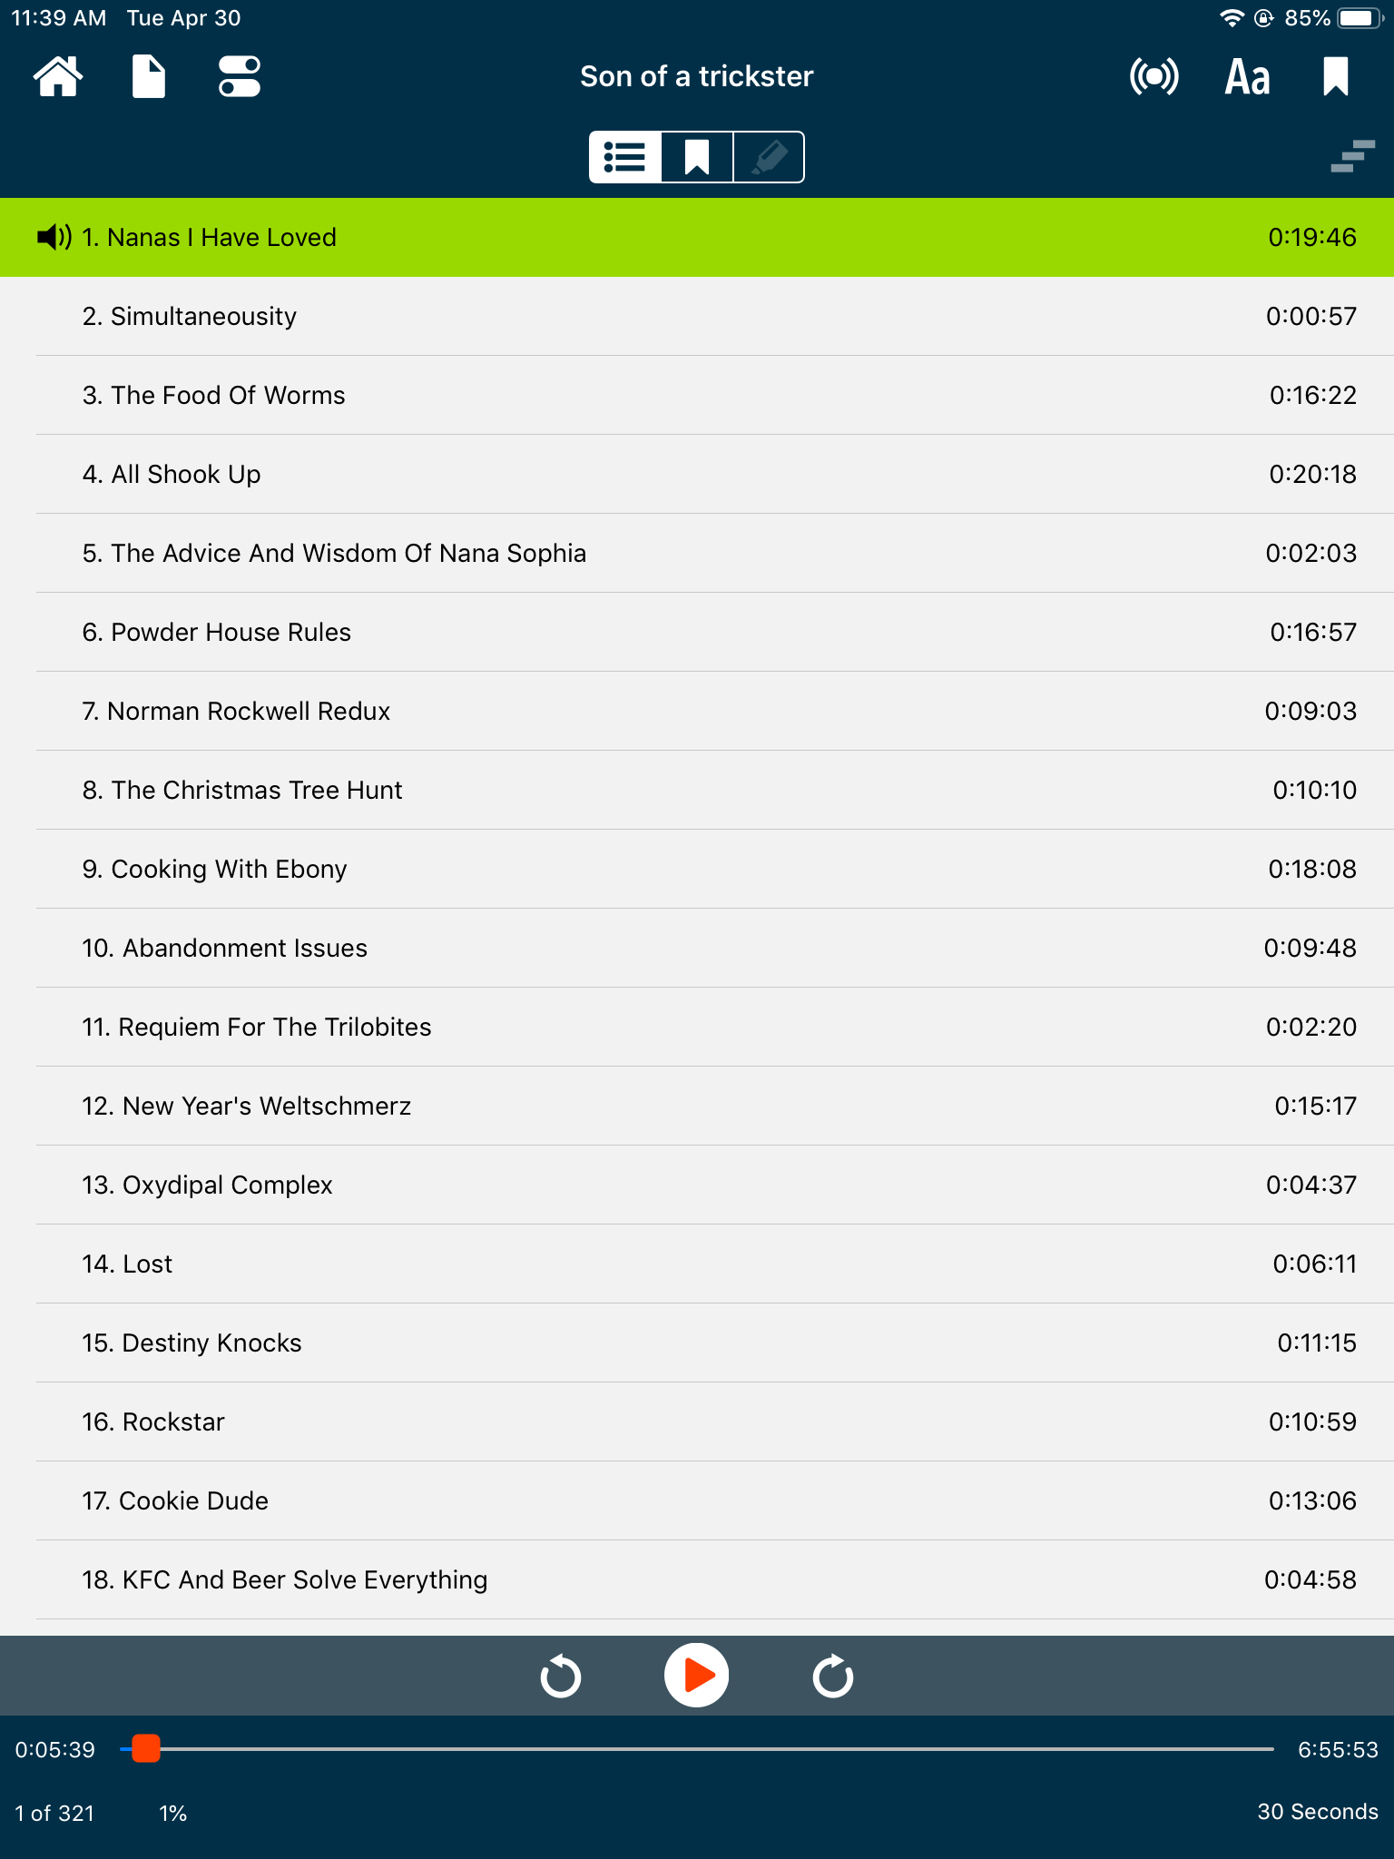
VoiceDream Reader

Slide 11
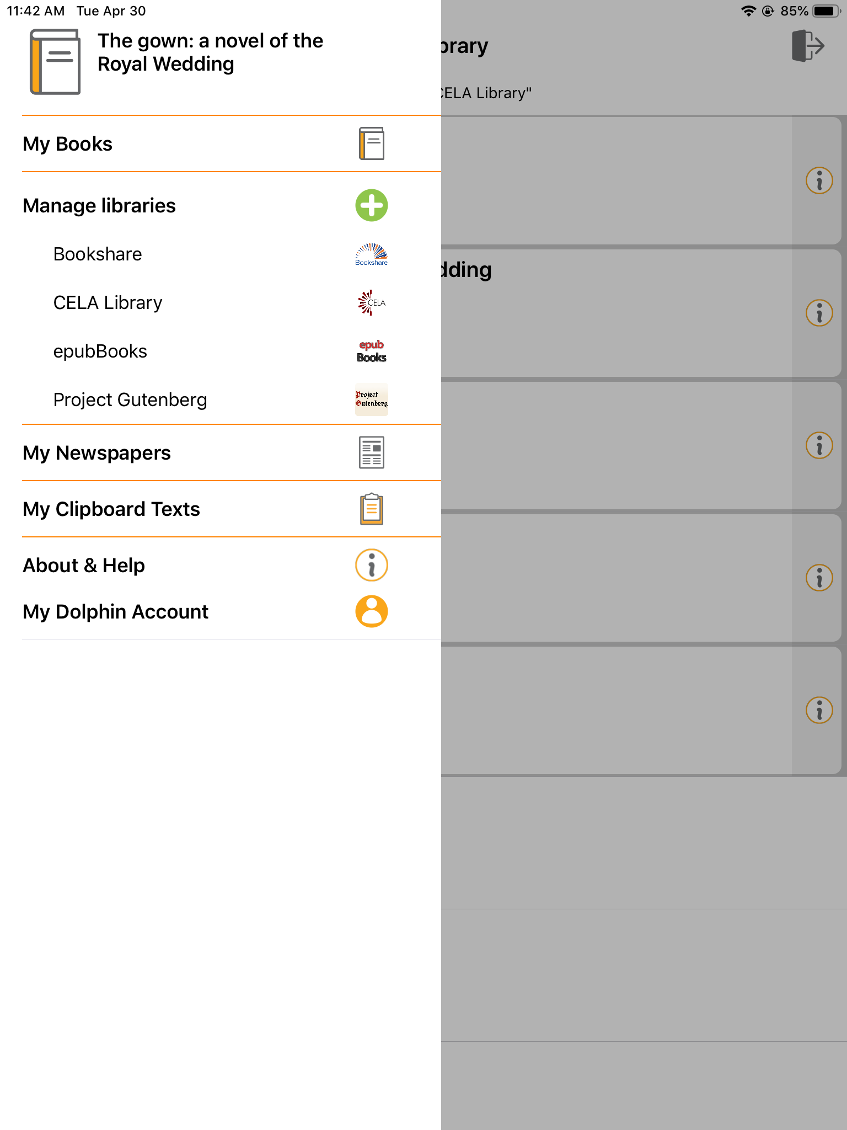
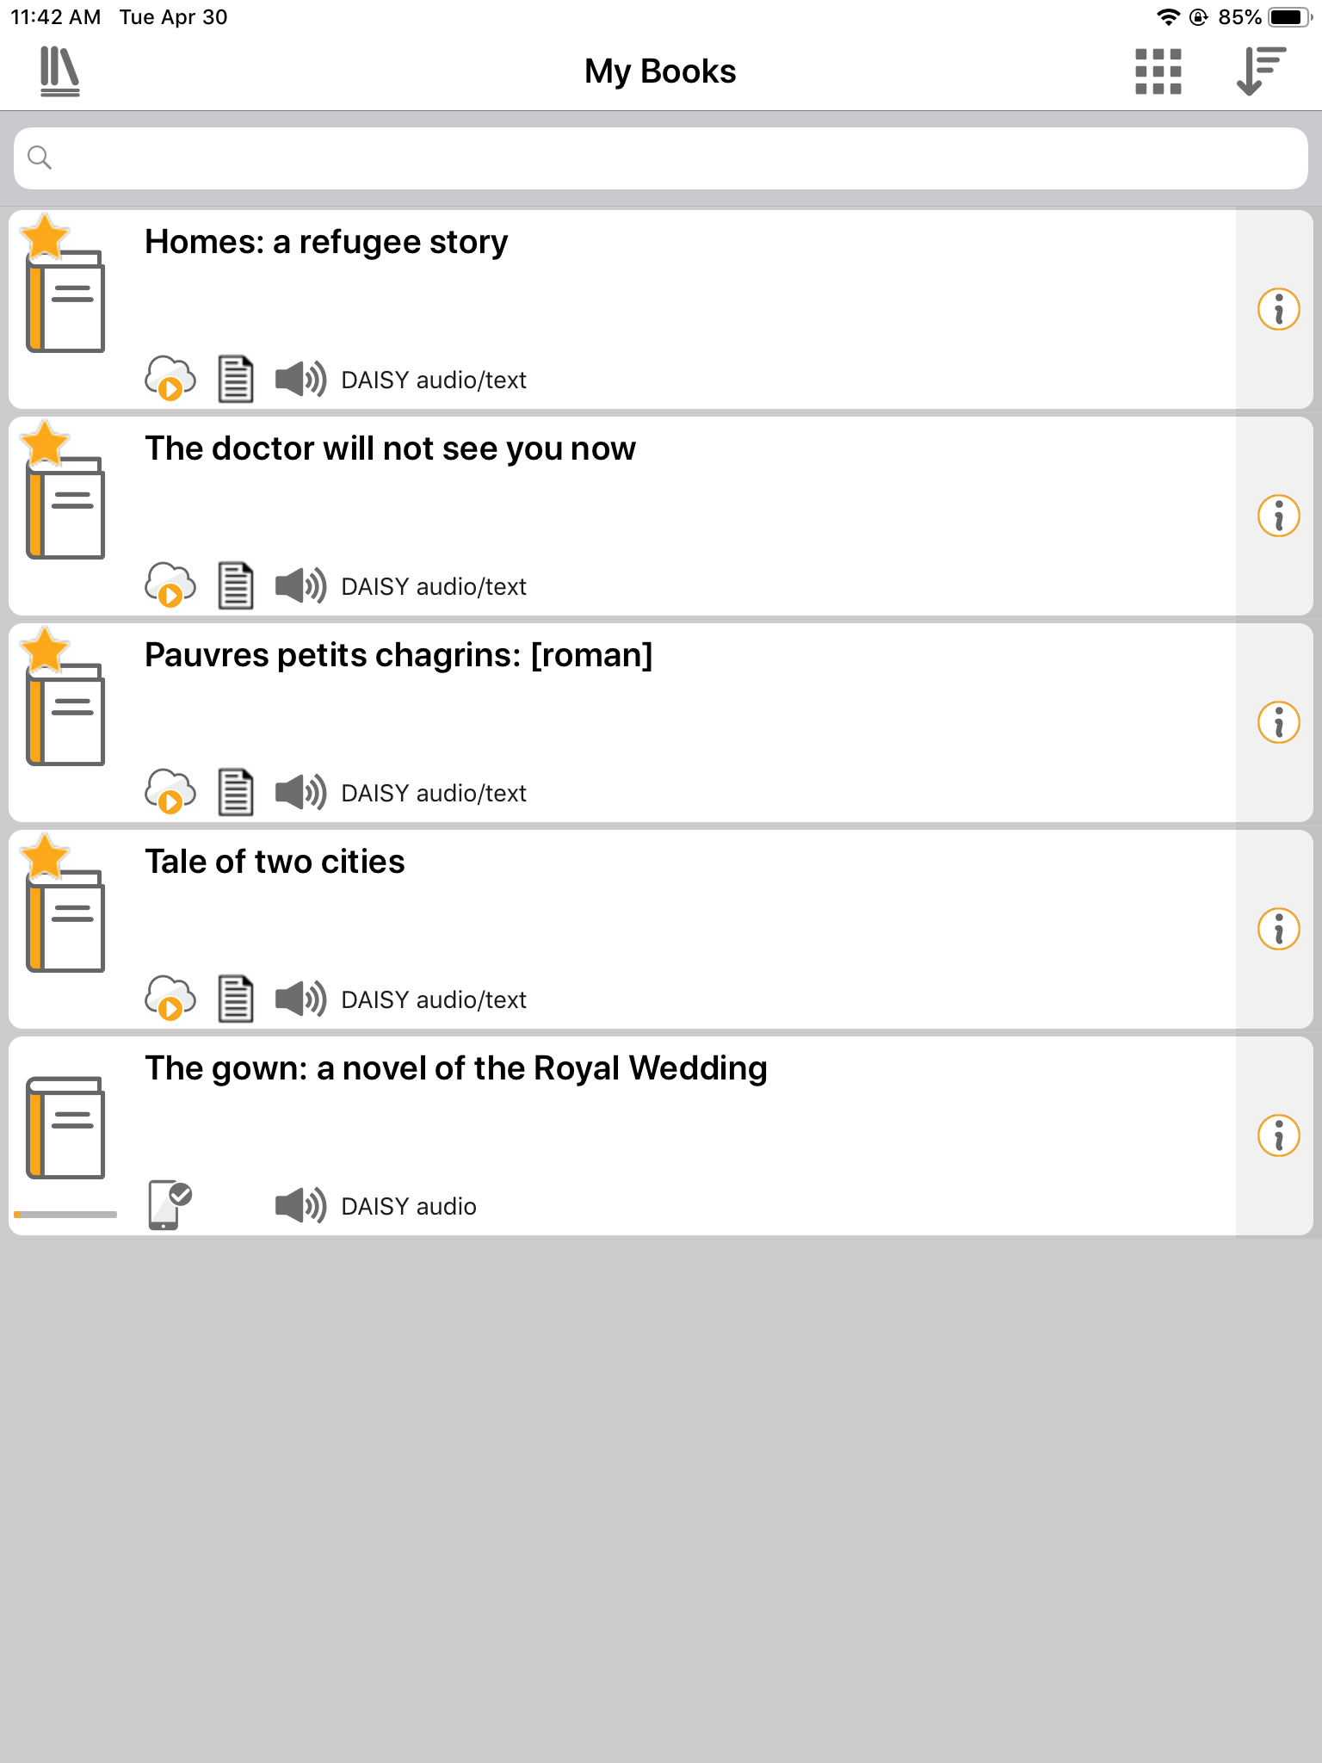
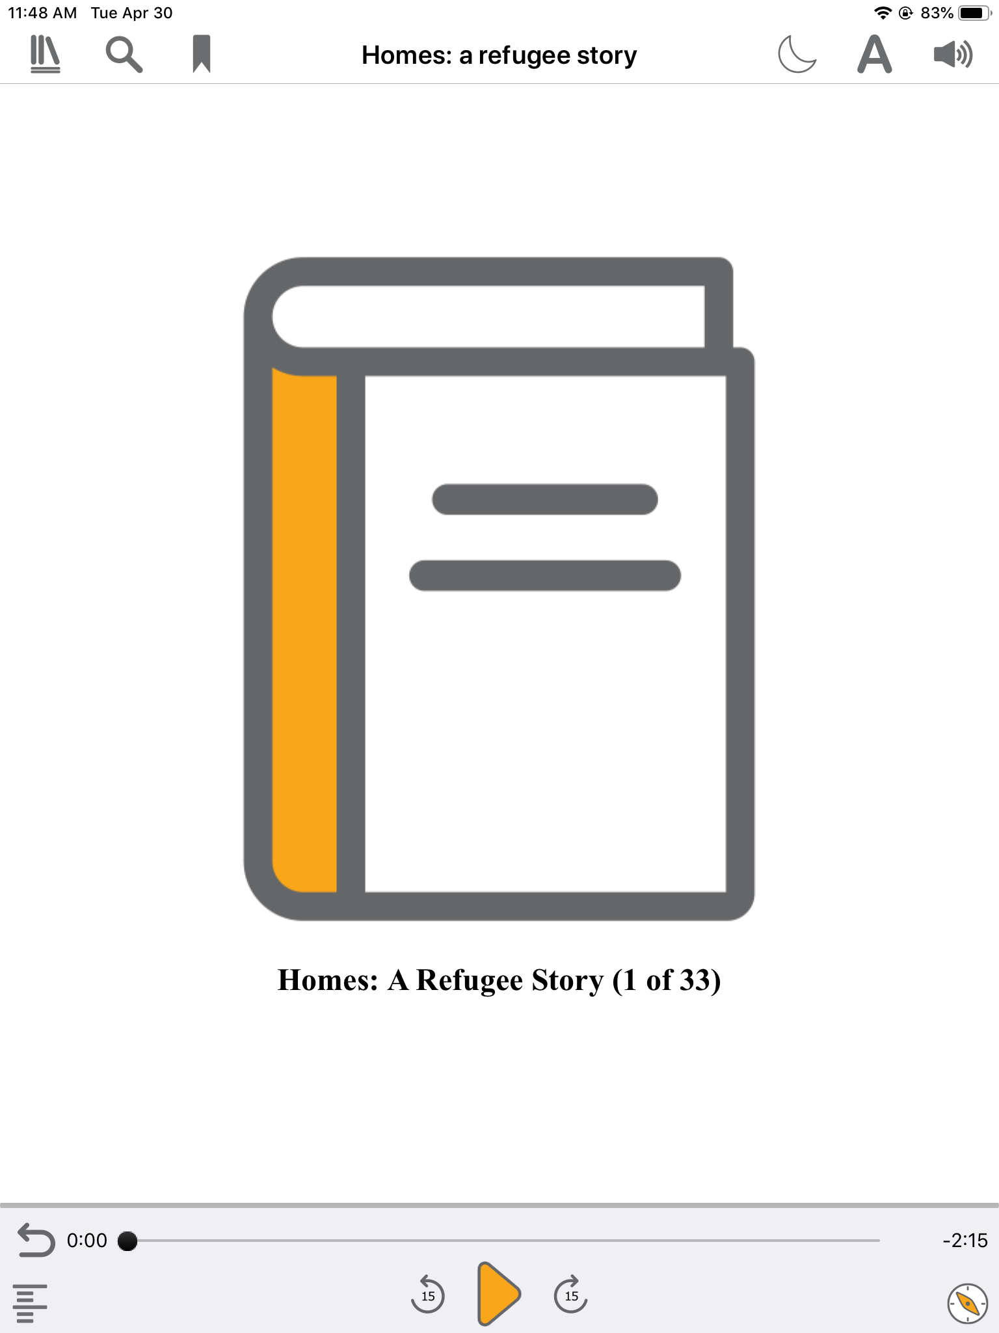
Dolphin EasyReader

Slide 12
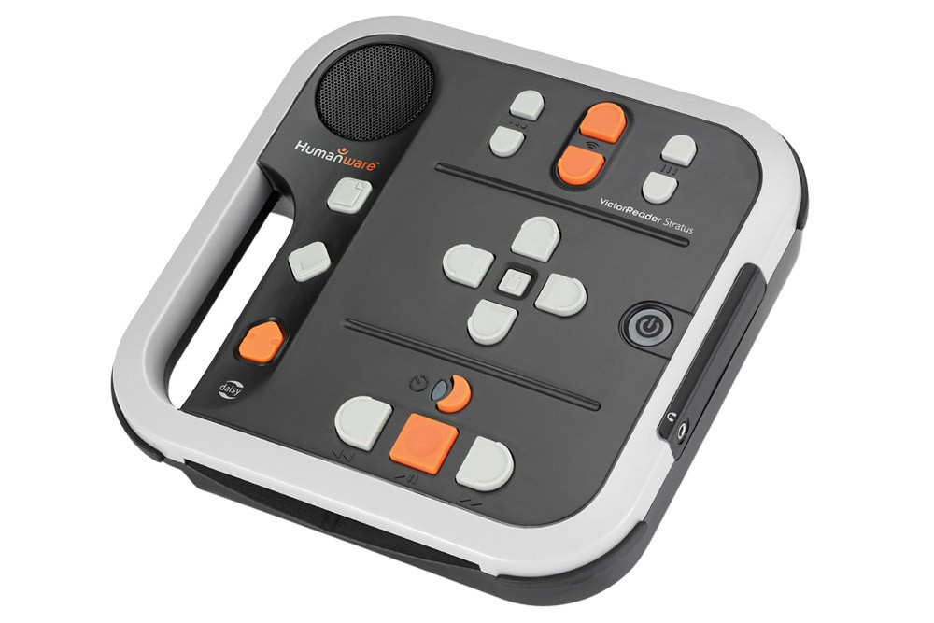
Tools and demos: DAISY players

Slide 13
Tools and demos: Refreshable braille displays, notetakers, and NVDA
NVDA (NonVisual Desktop Access) is an open source screen reader which enables blind and visually impaired people to use computers. It reads the text on the screen (with keyboard or mouse controls) in a computerized voice and allows the user to manipulate visual components of software with auditory feedback. https://www.nvaccess.org/
Braille displays and notetakers provide a tactile version of what is on the screen of a desktop computer, laptop, tablet, or smart phone. This equipment must have screen reading software to communicate with the braille display or notetaker.

Slide 14
Braille and braille literacy
Braille is a six-dot cell in two columns (from top down, dots 1, 2, 3, and 4, 5, 6).
See www.nnels.ca/braille to read more about braille, its history, and what Canada’s future plans are.
“Audio recordings and synthesized speech are useful tools, but they can’t replace the ability to read and write” – Braille Literacy Canada
For blind people, braille is the equivalent of the written word. “Braille is literacy, freedom … independence” –Albert Ruel

Slide 15
Audiobooks and role in literacy support
Students with dyslexia:
Combining print and audio increases comprehension of texts by 40% over print alone
Students can understand audio texts 2 grade levels above what they can understand in print
Audiobooks increase enjoyment of reading which contributes to positive attitudes towards reading
Audiobooks can be a useful literacy tool for people with dyslexia
*Statistics from Dyslexia Canada

Slide 16
Outreach: strategies for any library
Actively offer accessible services:
Include accessibility in the work you already do
Registering new people for library cards
Programming ex) offer alternate formats for book clubs
Include information about accessible services in any outreach you do
You know your community and where
Individuals with knowledge and interest make a big difference!
Notes:
Don’t assume people do not have a print disability or aren’t interested in accessible services.

Slide 17
Accessible library programs: Welcoming braille readers
Regular programming considerations:
Bring your own device for learning technology sessions. Encourage the presenter to use a microphone, descriptive language, as well as pictures and text. When possible, offer accessible electronic copies of presentations.
Simple ways to make the library physical space welcoming:
Ensure good clearance around obstacles; consistency in furniture placement
Inclusive story time using story boxes:
“Story boxes are a collection of items in a box or bag that corresponds to the items mentioned in a story” http://www.pathstoliteracy.org/storybox-ideas-norma-drissel

Slide 18
More programming ideas
Offer accessible formats along with print:
TD Summer Reading Club – accessible books and notebooks offered
One Book, One Province: Just Pretending by Lisa Bird-Wilson
One eRead Canada CULC: Glass Beads by Dawn Dumont
First Nations Communities Read 2019
Saskatchewan Book Awards 2019
CBC Canada Reads 2019

Slide 19
Future: Accessible Publishing
Working towards ‘born accessible’ publishing by:
Accessible Publishing Summit - https://www.accessiblepublishing.ca/
Accessible Publishing Workshops
EPUB Accessibility Reports/Audits
Daisy Consortium Partnership
Plugins for Publishers

Slide 20
Questions?
Riane Lapaire
SAFM Library
lapairer@spsd.sk.ca
Lindsay Tyler
CELA
lindsay.tyler@celalibrary.ca
Sabina Iseli-Otto
NNELS
support@nnels.ca

