Slide 1
Outcomes Based Library Planning – Part 2
Presented by:
Julie McKenna – Deputy Library Director
Nancy MacKenzie - Community Engagement and Programming

Slide 2
Session Outcomes
Participants will understand RPL’s outcome based planning journey to date
Participants will know why an outcomes based framework is essential for a customer centered culture
Participants will learn about the tools we have used

Slide 3
The Strategic Plan

Slide 4
Outcomes Framework
What is this?
Human centered understanding of needs and services
Drives planning and measuring service experience
Why did we choose this approach?
Traditional numbers based reporting and decision-making
Help our citizens, customers, staff, and political stakeholders understand the benefits of services and the risk of stopping support or funding
How will we use this?
Our management planning models at RPL already make way for this; we have done some successful work in this area in the past; our staff understand why this is important and timely

Slide 5
Using an Outcomes Based Framework
Concept | Definition | Example
Program/Service | What the library does | Summer learning
Inputs | Resources the library devotes to a program/service | Staff time, promotional material prizes
Outputs | What the library produces | Number of participants, program attendance, number of books read
Outcomes | Beneficial changes that occur because of the library’s program | Reading at grade level, success in school, graduation, continuing education
Impacts | Long-term or indirect positive effects of the outcomes | Love of reading and learning; entertainment, etc.

Slide 6
Outcomes
https://reginapubliclibrary.sharepoint.com/:v:/s/MarketingandCommunications/EWHh51FjJIpOiIto8R50digBrfHQO81IJhQ65tPxdZR1kg?e=K4ZZN3

Slide 7
RPL Inspires – Customer, Staff Engagement
Over 2,500 comments and suggestions from 991 participants
705 participants in the survey, of which 79 were potential customers
53 customer focus group participants
119 staff participants in the survey and 114 in staff workshops

Slide 8
What matters most to our community

Slide 10
Gap analysis - Programming
 | Importance | Experience | Gap
Programs and events for babies/preschoolers | 3.09 | 3.49 | .40
Film Theatre Programs | 3.07 | 3.43 | .36
Dunlop Art Gallery exhibitions | 2.86 | 3.16 | .30
Programs and events for school aged children | 3.22 | 3.33 | .11
Programs and events for adults | 3.22 | 3.32 | .10
Programs and events for families | 3.14 | 3.23 | .09
Programs and events for seniors | 3.22 | 3.17 | -.05
Programs and events for teens | 3.03 | 2.86 | -.17

Slide 11
Outcome Teams
Terms of Reference
Composition of Teams
The Tools
Service canvas
Program Logic Models

Slide 12
Tools – Service Canvas
Name of New Collection: Story Bags |  |  | URL of eResource/Database:
What is the problem, gap or issue, goal? | Describe the service: |  |  | How does the service benefit our customers? | Who are the target group/customers?
How is it being addressed today? Would there be duplication? What other products duplicate this service that are not offered by RPL? | How will we measure success? |  |  | Who are our key partners?
 |  |  |  | What are the key channels we could use to market the service?
 |  |  |  | Website tie-in
What resources are needed to make this proposed Collection/Service possible? |  | What issues do we need to address (include issues of access in RPL’s inclusive environment?
Budget:

Slide 13
Tools – Service Canvas
What is the problem, gap or issue, goal?
Describe the service?
How does the service benefit our customers?
Who are the target group/customers?
How is it being addressed today? Would there be duplication? What other products duplicate this service that are not offered by RPL?
How will we measure success?
Who are our key partners?
What resources are need to make this proposed Collection/Service possible?
What issues need to be addressed?
Budget?

Slide 14
Tools – Program Logic Models
Used for design, planning, communication, evaluation, & learning
Shaping Outcomes: Making a Difference in Libraries and Museums
Outcomes Based Planning and Evaluation (OBPE) Model
http://www.shapingoutcomes.org/
Rubin, Rhea Joyce, Demonstrating Results: Using Outcome Measurement in Your Library. Chicago: ALA Editions, 2006
Notes:
(McDavid and Hawthorne 2006)

Slide 15
The Strategic Plan

Slide 16
Mission Statement – 4 Pillars
Free and open access to resources
Community space where people and ideas meet
Programs and services that support reading, curiosity, and learning
Community opportunities that complement and strengthen the public library offering

Slide 17
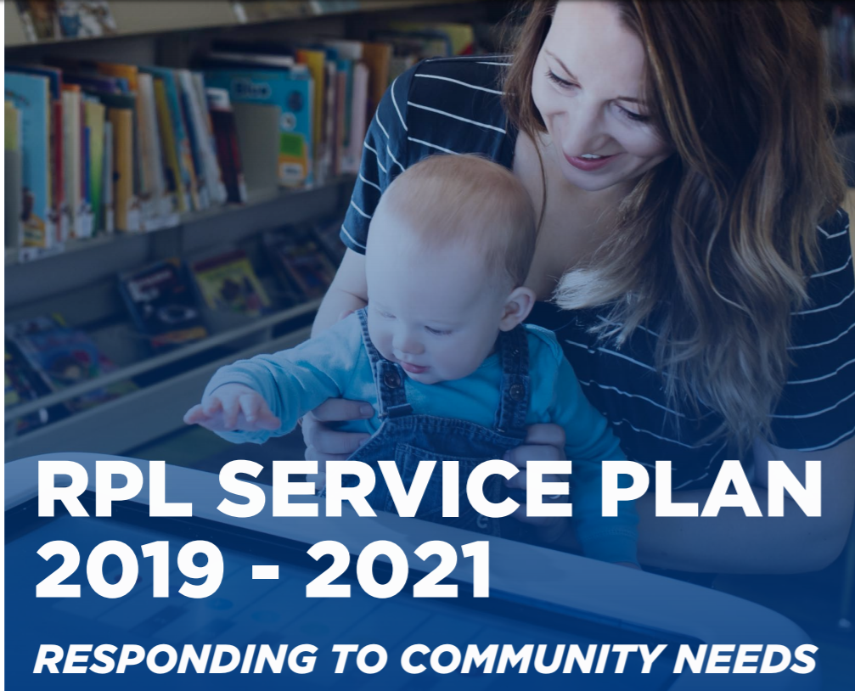
Notes:
Nancy

Slide 18
Mission Statement – 4 Pillars
Free and open access to resources
Community space where people and ideas meet
Programs and services that support reading, curiosity, and learning
Community opportunities that complement and strengthen the public library offering

Slide 19
2. Community Space where People and Ideas Meet GOALS

Slide 21
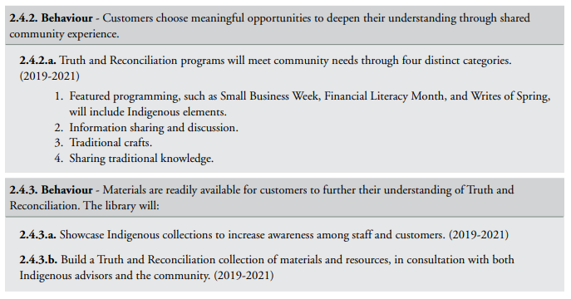

Slide 22
Getting the Work Done
Operational Plans
Performance Planning and Review – launched new in 2019
Internal communication
Board reporting
Community reporting
Team projects – big cross functional changes

Slide 23
Teams
Activating Central
Inclusion
Reading
Truth and Reconciliation

Slide 24
Evaluation
From the customer’s perspective
Continuous iterative loop = Continuous learning & improvement
Understand needs
Design
Deliver
Evaluate
Quantitative
Qualitative

Slide 25
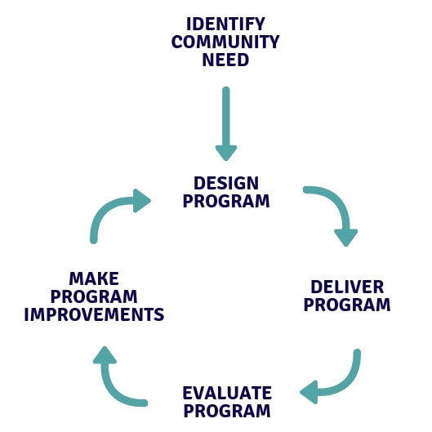

Slide 26
Session Outcomes
Participants will understand RPL’s outcome based planning journey to date
Participants will know why outcomes based framework is essential for a customer centered culture
Participants will learn about tools that RPL tools have been beneficial

Slide 27
Outcomes Based Library Planning – Part 2
jmckenna@reginalibrary.ca
nmackenzie@reginalibrary.ca

