Slide 1
Research that goes bump in the night
Jaclyn McLean
Saskatchewan Libraries 2019
Notes:
Greeting, introduction, thank you for coming

Slide 2
What we’ll talk about today
A bit about my experience as a beginner practitioner-researcher
Details of my first solo research study
Initial findings from the study
Discussion and sharing of ideas
Notes:
I’m hoping today’s presentation might help you feel a little less alone—that by sharing my experiences with my first major research project as a solo researcher, and what I’ve learned along the way and by sharing your experiences, we can all feel more confident in our ideas.

Slide 3
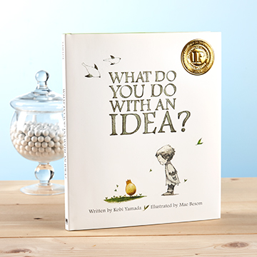
“What do you do with an idea? Especially an idea that’s different, or daring, or just a little wild?
Do you hide it? Walk away from it? Do you pretend it isn’t yours?”
~flyleaf, What do you do with an idea
by Kobi Yamada
Notes:
I’ll be using this book as a bit of a framework for the talk today, and I’ve got a copy up here if you haven’t read it before and want to check it out after.
The flyleaf further reads: “This is a story for anyone, at any age, who’s ever had an idea that seemed a little too big, too odd, too difficult. It’s a story to inspire you to welcome that idea, to give it some space to grow, and to see what happens next. Because your idea isn’t going anywhere. In fact, it’s just getting started.”
I came across this book a couple of years ago, when I was still trying to find my feet as a librarian practitioner-researcher, and feeling a bit like all my ideas for research were too small, to insignificant, too silly, and no one would ever care about it. Then I found this book, and it encouraged me to just try following one of my ideas. So I did. And it became the project I’m going to talk to you all about today. A project that I have wrestled with, an idea that outgrew the possibility and capacity of a single researcher, and an idea that has haunted me now for 3 years.
For those of you unfamiliar with the story, it’s about a child who has an idea, and they try to avoid it at first, and hide it, embarrassed what others will think. But when they encourage the idea, feed it good food, and let it grow and start to enjoy being with the idea and being brave enough to share it with others, it grows and grows in brilliance, and eventually changes the world.
Now, I’m not saying that my research is going to change the world—but I’ve gone back to this idea of “what do you do with an idea” several times over the past 3 years with this research project. At times it’s felt like an idea I want to run away from, or abandon, but it’s when I started to talk about how I was feeling about the project, and my challenges, with others, that I was able to remember the core of my question, and why I was interested in the research. By showing my idea to others and talking about it, it has become better. And gone from a project that I was avoiding and hiding from to one I’m excited to wrap up and share results from. Even if it doesn’t change the world, it’s still my idea. And it’s time for me to share it.

Slide 4
“I worried what others would think. What would people say about my idea?”

Slide 5
Identifying journals and topics instrumental to librarian practitioner professional practice and development
Notes:
This is the research project I am discussing today. I started work on this project in the autumn of 2016, inspired by an article I read for our journal club at the University of Saskatchewan earlier that year. It is the first research project/question I defined as a new researcher, and my experiences along the way the last 3 years have made that very clear. I’ve had issues with scope, and the feasibility of collecting the volume of data I would need for my originally planned analysis, and then scope again, and have set the project aside more than once, feeling like it will never actually see the light of day.
I originally envisioned this as a pilot study for a national survey and maybe even some interviews when I went on sabbatical, of course funded by a SSHRC grant. So I was ambitious.
My research question originally was to examine whether practitioners rely more on research produced by other practitioners (someone working in a library), or by academics (defined as faculty at a library school)? I created a survey and gathered a list of names for targeted recruitment of any librarians working in Saskatchewan. I asked them about the journals they use to inform their practice, and if they produce their own research, where they publish. I also asked about non professional literature/journal sources—where else were practitioners seeking information to support their work? I planned to download the citation data from each of the top identified journal titles for published research and analyze the content. I planned to do content analysis on the titles and also collect information on the authorship of the articles—whether they were practitioners or academics. And also include the information about where my participants publish. And then I was going to refine the survey, and take it national! So you may have some ideas where I ran into problems already…I was dreaming really big, and my eyes were definitely bigger than my stomach.
I’m going to describe my process, and hope that you’ll also share your ideas along the way today.

Slide 6
Notes:
This is a good visualization of my process on this project. From an idea, to a cycle of editing and re-scoping and re-evaluating the value and purpose of the research. It’s a good visualization for the research process in general, most likely. Though this is where I got stuck—in a loop of editing and reassessing my plan, and I still wasn’t feeling very happy about things.

Slide 7
Notes:
I got a little lost. I kept going back to the original study that had first inspired me, and really zeroed in on their methods, on which I’d based mine. And realized that they had a whole team of researchers & research assistants, and they’d applied a very restrictive scope on their data analysis. I had asked too many questions on my survey. I had made the fatal mistake that researchers sometimes make—I’d asked questions without really thinking about what I would use the data for. I had so much varied data that it would take me years to adequately do the kind of analysis I wanted to do. So now what?

Slide 8
How do you workshop your ideas?
Make lists? Talk to others?
Notes:
Discussion, after I share what I’ve done

Slide 9
Identifying journals and topics instrumental to librarian practitioner professional practice and development
idea
apply for grant
get grant
analyse
survey
Notes:
So I was stuck at analysis, and a bit paralyzed. It was time for my first re-evaluation of the project. It was suggested that I apply for the President’s SSHRC grant at USASK, a grant that is aimed at helping researchers complete pilot or initial research, and go through the process of grant application before applying for a tri-council grant.
I spent a lot of late autumn and early winter 2016 writing my grant application. I felt good. The scope had been cleaned up, made more limited, and I had a better understanding of what I could do.

Slide 10
Notes:
And then I wasn’t awarded the grant—I hadn’t done a good enough job describing my project to a non-library audience. And I got knocked back a few paces. This was the kinder of the two evaluations of my application. At the time, as I mentioned, I hadn’t done much other research, and this was my first experience writing a significant grant application. So my ego was a little bruised.

Slide 11
“They said it was no good. They said it was too weird. They said it was a waste of time and that it would never become anything.”
Notes:
I got stuck. I had hired a student to do some initial work with my startup grant as new faculty, but it was clearly not going to be enough.

Slide 12
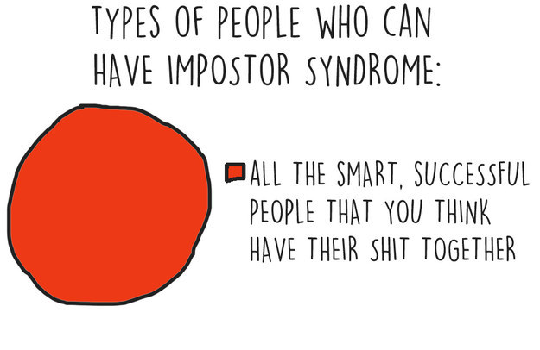
https://www.buzzfeed.com/kristinchirico/13-charts-that-will-make-total-sense-to-people-with-impostor?utm_term=.pmnxk3Jb7&sub=4105639_7727040
Notes:
When I had to sit down and revise the application, this is how I began to feel about the project. That moment of impostor syndrome, and I doubted whether this project should even go forward. I was stuck.

Slide 13
What do you do when you get stuck?
Get discouraged? Feel energized? Talk it out?
Hide from it?
Wish it would go away?
Notes:
Discussion, then share my strategies.
It’s important to not let your idea become a problem—another great book by Kobi Yamada if you weren’t already aware of it!
I avoided the problem for awhile, but had a very supportive team to help me be a successful researcher. So with support from our research facilitator, I made myself read the feedback I’d received on my first application for the grant, and take it in. And I started to revise. I re-scoped the project again, limited things further, and tried to address the issues that had been identified the first time I applied.

Slide 14
Identifying journals and topics instrumental to librarian practitioner professional practice and development
idea
apply for grant
get grant
analyse
more grant $
student research assistants
re-scope
survey
Notes:
I was successful the second time I applied, after modifying my scope a bit, and rewriting my application with less jargon and more explanation about the value of librarian research. I got feedback again that my scope was too ambitious, but at the time, stuck to my guns. This was my project, and come hell or high water, I wasn’t going to bend…
So I hired an undergraduate student research assistant in September 2017, brought her up to speed on the project, trained her on how to download the citation information from the journals identified in my survey, and how to identify a research article, and we were off! Finally! Progress!
And then she had a really busy term, and worked maybe 3 hours a week. And I had started working on 3 other projects that were at different phases, so this project just hung out for a few months. I was too busy to manage it appropriately, and my student was too busy being a successful student to work very much. It was a bit of a problem. My RA would work when she could, and I’d answer questions, but by February I was frustrated—I was never going to get anything done at this rate, because any progress on the project depended on having the data collected, and it didn’t seem to be getting going. A big issue is that downloading journal citations is very boring work, with not much reward, so obviously my RA wasn’t thrilled with the work. And the entire project was stalled until I had all the citations. It was a vicious cycle.
In April I got permission to hire a second student. I ran interviews, and hired a second student in May. And then she went home for the summer, and couldn’t start work until September. And in September, I got both my students together, re-scoped the project again because it was pretty clear I wasn’t going to be able to collect as many citations as I originally planned. And my first student RA told me she was now only doing part-time classes, and would like to work basically full time for me. FACEPALM. I distributed the work among my two RAs, and in fall 2018 the project finally got some momentum. My student RAs have been great, really enthusiastic and curious about being a librarian and what librarian research looks like.

Slide 15
“It shared its secrets with me. It showed me how to walk on my hands. ‘Because,’ it said ‘it is good to have the ability to see things differently.’”
Notes:
I started to feel good. By Christmas break, the citation information I’d been waiting for was finished, my RAs told me. In January this year, I dove in and started trying to make sense of the data. Exhilaration—finally I was doing analysis like I’d been planning for so long.

Slide 16
Identifying journals and topics instrumental to librarian practitioner professional practice and development
idea
apply for grant
get grant
analyse
more grant $
student research assistants
re-scope
more analysis
survey
Notes:
And then I had to re-scope a bit again. What was I going to do with this information? I’d collected citation information for 4,276 research articles. And hadn’t done a good job of defining data parameters. My RAs had used different citation styles when downloading the information. Which is a bit of a big deal when you want to create a consistent data set of the citation information. So I started cleaning data, using Excel & OpenRefine & Notepad for the different things I had to do to isolate each piece of information about each article—because the citation had been dropped into a single cell on a spreadsheet.
So many data lessons here. It could be another whole presentation! If you’re curious about some of my data learnings and why I’ve done data management plans for subsequent projects, please ask me at the end!
And when I dove into analysis, I also found that some of the information was incomplete—so I had to assign more work to my RAs, and felt like I’d never really get to analysis the way I wanted to.

Slide 17
Notes:
I had another little spiral. And then I decided that enough was enough! I had invested a lot of time and energy into this project, and used grant funding for it. I wasn’t going to waste all that time and money. I met with our research facilitator, and she helped me re-scope again. And then I talked about it with others—about how I had this project that just felt like it would never end, and I was hating it. I reached out to others instead of spiraling out. And heard from other, more experienced researchers about their own struggles with projects that had gotten out of control, or had never seen the light of day, and realized I wasn’t alone.
My idea was a good one, my project has value, it just took some time to remind myself of it again. And to make a plan for dissemination that was different from my original one—that my plan for analysis would be different too. But that’s okay.

Slide 18
Notes:
So now I was finally out of the iterative, ongoing re-scoping process, and feeling good about this project—and that’s how you hope you’ll always end up.

Slide 19
How do you lift others up? Or ask for help when you need it?
Notes:
Discussion
I hope the value of mentorship and professionally supporting each other is clear, and maybe you’ve identified some new strategies or ideas, about how you can ask for help, or offer it to others.
Not hiding from your idea and letting it grow into a big and overwhelming problem is the first step—you don’t want it to grow into a bogeyman that keeps you up at night.

Slide 20
Details of the study
Notes:
To wrap up, I’m going to present some of the actual data from my study, and there will still be more time at the end for further discussion or questions.

Slide 21
Survey participants
Geography: Saskatchewan
# of participants: 67
Do you use research journals?: Yes – 60
Have you published an article: Yes – 20
(in the last 5 years)

Slide 22
Survey participants
Sector
Academic | 27
Public | 25
Special | 13
School | 0
null | 2
Stage of Career
Early (<6 years) | 12
Mid (6-24 years) | 45
Senior (>24 years) | 10
Notes:
Slow down, explain the data better—especially why no schools & what is null?

Slide 23
Journals identified in survey
Library Journal
College & Research Libraries
Partnership: the Canadian Journal of Library and Information Science
Journal of Academic Librarianship
Computers in Libraries
American Libraries
Evidence Based Library and Information Practice
School Library Journal
Journal of the Medical Library Association (JMLA)
Public Libraries
Booklist
Portal
Quill and Quire
College & Research Libraries News
Journal of the Canadian Health Libraries Association
Library Management
Against the Grain
Health Information and Libraries Journal
Reference and User Services Quarterly
Library Trends
Journal of Information Literacy
Medical Reference Services Quarterly
Journal of Library Administration
Notes:
A total of 126 journals were identified, and 23 were identified at least 3 times each. These are the titles that were identified in the second question for my survey, after asking whether the participant uses journal literature, they were asked to “please list 5-10 academic/research/professional journals you read or consult to support your practice and/or research as a librarian.”

Slide 24
Journals without research articles
Library Journal
Computers in Libraries
American Libraries
School Library Journal
Booklist
Portal
Quill and Quire
College & Research Libraries News
Against the Grain
Health Information and Libraries Journal
Reference and User Services Quarterly
Library Trends
Journal of Information Literacy
Medical Reference Services Quarterly
Notes:
Of the top 23, 12 of them don’t publish research articles that met the definition for my study.

Slide 25
Journals with research articles
College & Research Libraries
Evidence Based Library and Information Practice
Journal of Academic Librarianship
Journal of Library Administration
Journal of the Canadian Health Libraries Association
Journal of the Medical Library Association (JMLA)
Library Management
Medical Reference Services Quarterly
Partnership: the Canadian Journal of Library and Information Science
Portal
Public Libraries
Notes:
Of those 23 top journals, 11 publish research articles. I defined research articles for this study as articles in a research section of the journal, and/or containing a reference list and not obviously one of the other standard types of journal features (editorials, book reviews, etc.).
From these 11 journals, we downloaded the citation for all research articles published for a 10 year period, from 2008 – 2017.

Slide 26
Initial analysis of titles
Notes:
These articles also seem to have descriptive titles that are mostly positive. I ran an initial NVivo analysis of the titles, and these are some of the early findings based on the tone of the article titles
Very negative: 31
Moderately negative: 96
Moderately positive: 211
Very positive: 32
Generally, when I think of articles I’ve used for my own research, they tend to be declarative. After I looked at this analysis of my dataset, I went back and found a few examples that were really interesting:
A Guide to Wiping the Egg Off Your Face
Linux Is for Everyone; Librarians Included!
Mandatory Open Access Publishing for Electronic Theses and Dissertations: Ethics and Enthusiasm
Millennials among the Professional Workforce in Academic Libraries: Their Perspective on Leadership
Mirrors and Windows. Diversity in Children's Picture Books
Rising Tides: Faculty Expectations of Library Websites.

Slide 27
Notes:
I’ve completed some preliminary analysis of the article titles themselves, and some clear early themes are emerging.
There are 5,2952 unique words expressed in the article titles. The top words are:
Library (1,322)
Academic (739)
Information (703)
Libraries (702)
Research (427)
Study (392)
Librarians (363)
Health (334)
Students (322)
Literacy (283)
It’s pretty clear that as a profession, at least in these identified journals, our research is about ourselves—about libraries, librarians, information, and most often related to academics, health, students and literacy.

Slide 28
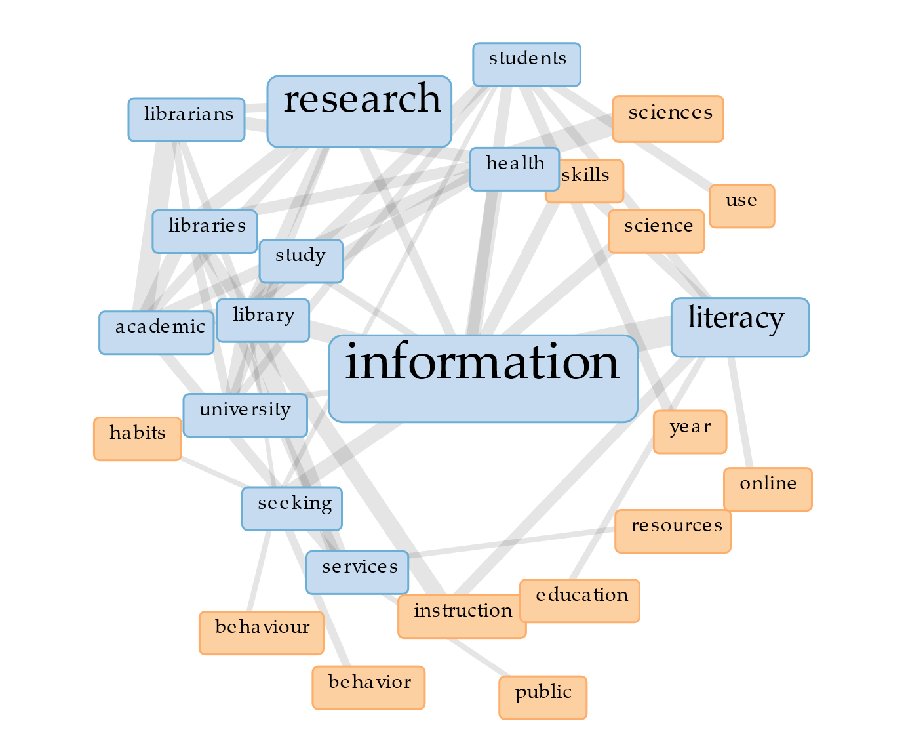
Notes:
These are the words generally linked to the most popular 3 words. The size is relative to the frequency, and the blue ones are more prominent in the entire data set.

Slide 29
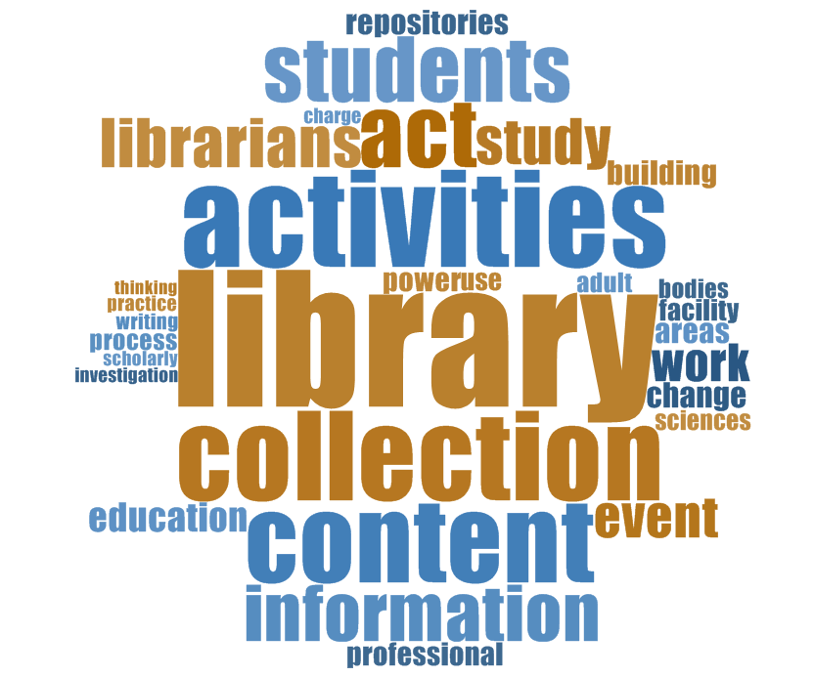
Notes:
NVivo can do more specialized word clouds, and cluster together the stemmed words and synonyms to provide a more meaningful look at the data—especially in this set, where there’s library/libraries, and other similar words that can be easier to analyse if those synonyms are already collapsed into a single term for me, for initial analysis anyway.
Here we’ve got more words to look at and think about. Words like content, education, change, process, practice, repositories, professional.

Slide 30
Identifying journals and topics instrumental to librarian practitioner professional practice and development
idea
apply for grant
get grant
analyse
more grant $
student research assistants
re-scope
more analysis
dissemination
survey
Notes:
As I mentioned, I’m just at the beginning of my analysis phase, and starting to think about dissemination of my results. I’ve got a scope for the project that feels manageable, and a plan for dissemination—after this presentation, I’ll continue my content analysis of the article titles, and see if there are other themes that can be pulled from my survey results.
I’m going to make the dataset of citations available as an open dataset, so others can apply their own research questions to them. And I’m going to write an article about the study and its findings.

Slide 31
“And then, I realized what you do with an idea…
You change the world.”
Notes:
I hope you also feel that your ideas are valuable and important and unique, and perhaps there’s something you’ve had on the back burner for awhile that you’re now thinking about reviving, so your little idea has a chance to change the world.

Slide 32
Thanks!
Any questions?
You can find me @superjax jaclyn.mclean@usask.ca
Notes:
Thank you—more discussion/questions?

Slide 33
Credits
Special thanks to all the people who made & released these awesome resources for free: SlidesCarnival
All quotes from What do you do with an idea, written by Kobi Yamada, illustrated by Mae Besom (ISBN 978-1-938298-07-3), 2013.
All images are CC0, from Pixabay

