Slide 1
Refreshing Saskatchewan Polytechnic’s Copyright Web Presence
Alan Kilpatrick, Reference Librarian
Law Society of Saskatchewan Library
(Regina)

Slide 2
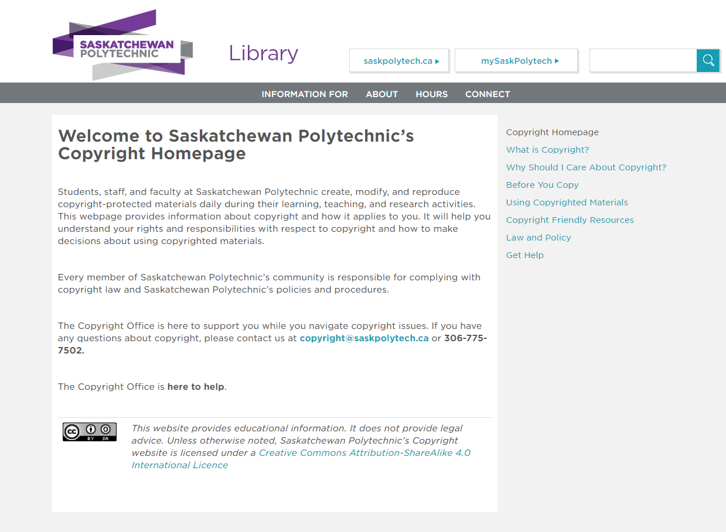
Why Refresh?
library.saskpolytech.ca/copyright.aspx

Slide 3
Refreshing Saskatchewan Polytechnic’s Copyright Web Presence
Alan Kilpatrick, Reference Librarian
Law Society of Saskatchewan Library
(Regina)

Slide 4
Why Refresh?

Slide 5
Literature Review
Horava, T. (2008). Webpages on Copyright in Canadian Academic Libraries.
Proposes a model and a series of objectives for academic library copyright webpages. It presents the results of a survey of Canadian academic library copyright webpages and recommends best practices.
Horava, T. (2010). Copyright Communication in Canadian Academic Libraries: A National Survey.
Presents the results of a national survey of Canadian academic libraries. The survey investigated the methods of copyright communication used by academic libraries.
Graham, R., & Winters C. (2016). Copyright Practices and Approaches at Canadian Universities: Report of a National Survey.
Updates Horava’s 2010 survey. It investigated how postsecondary copyright communication approaches have changed since 2010.

Slide 6
Best Practices
Visible and accessible
Clearly worded
Well organized
Educational
Provide contact information
Promote respect for copyright
Promote alternatives

Slide 7
Risk Tolerance
Public-facing site:
Students, potential students, and the outside world
Internal site:
Faculty, course developers, and staff

Slide 8
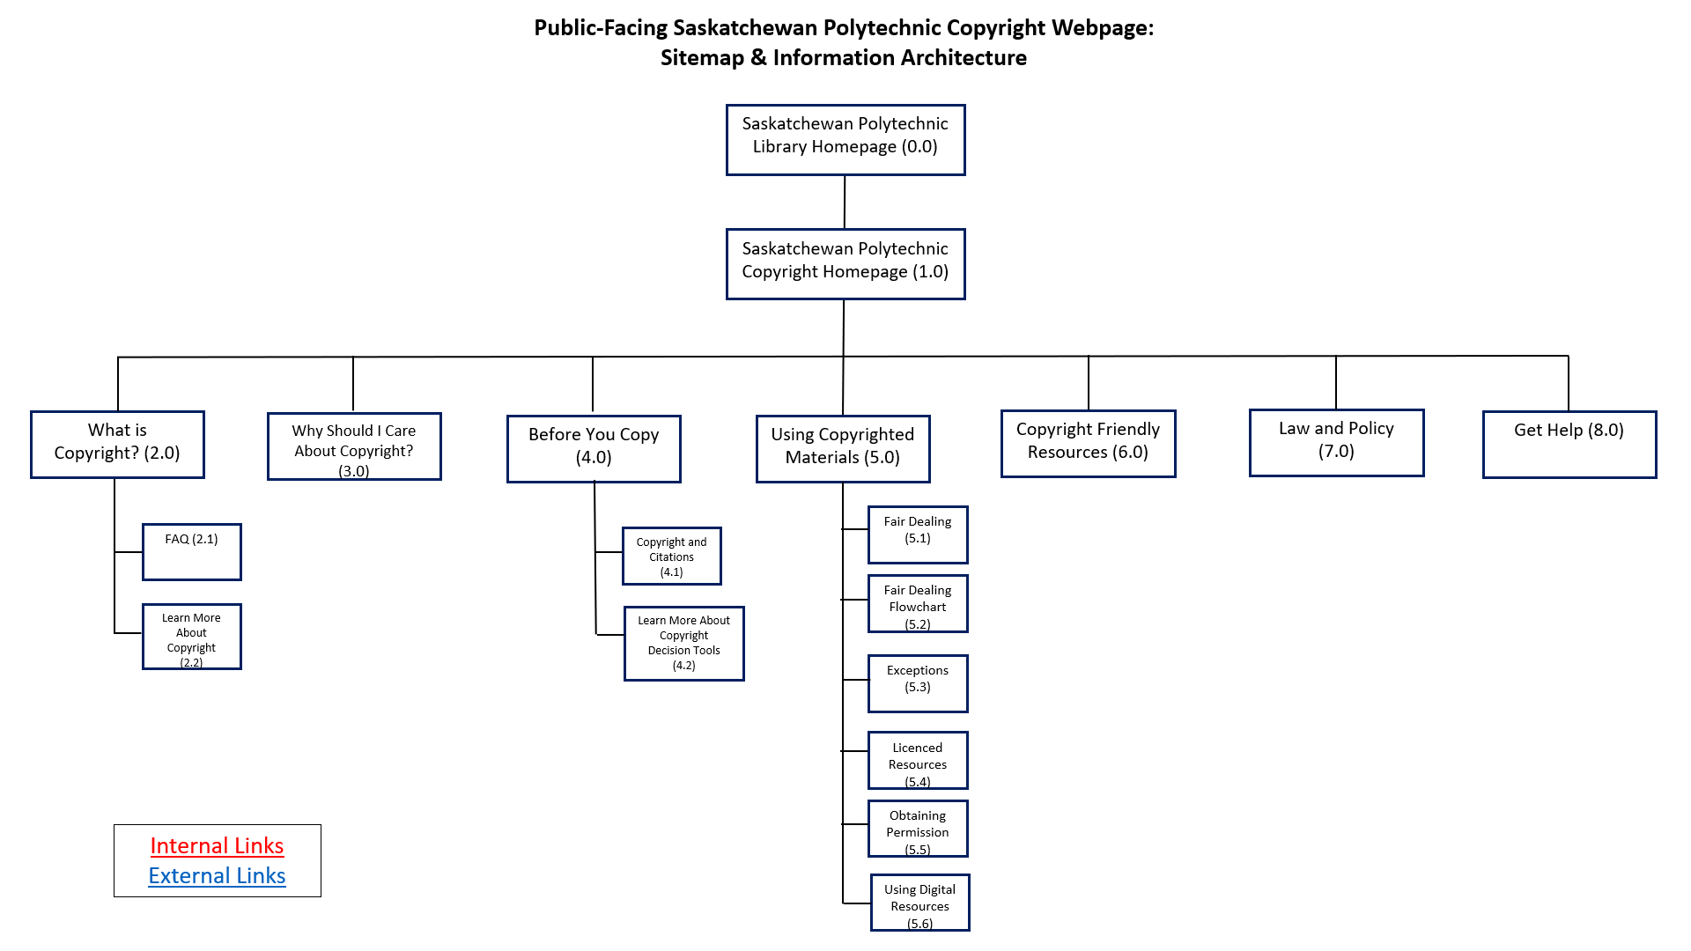

Slide 9
Site Content
My goal when writing the content was:
​To make the language clear and understandable
To provide a good overview without being overwhelming

Slide 10
Why Refresh?

Slide 11
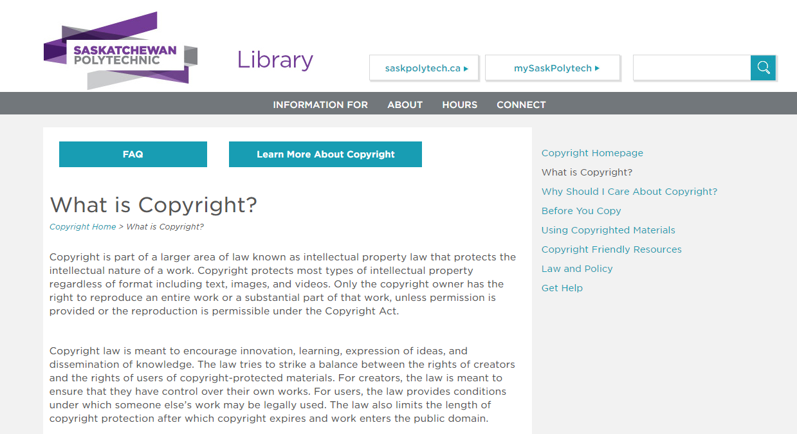
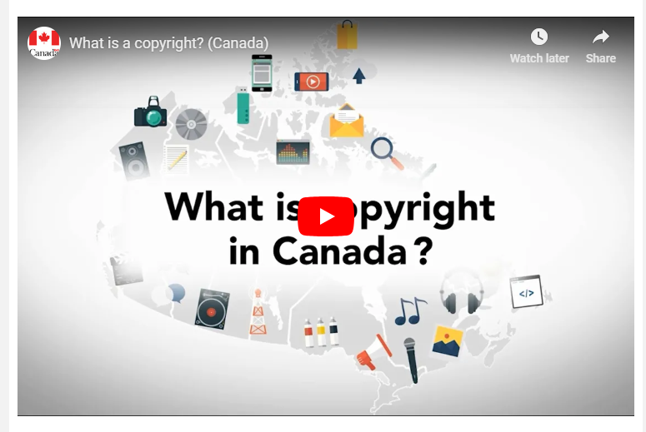

Slide 12
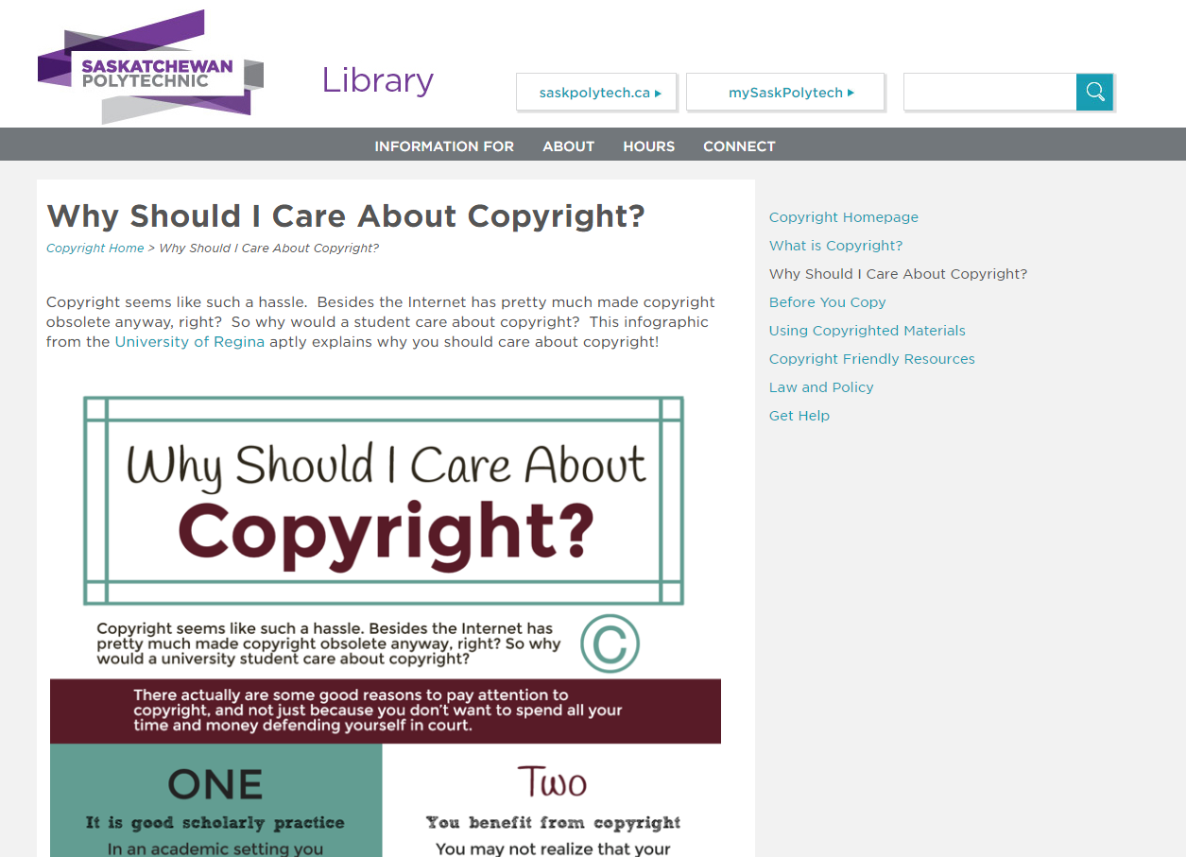

Slide 13
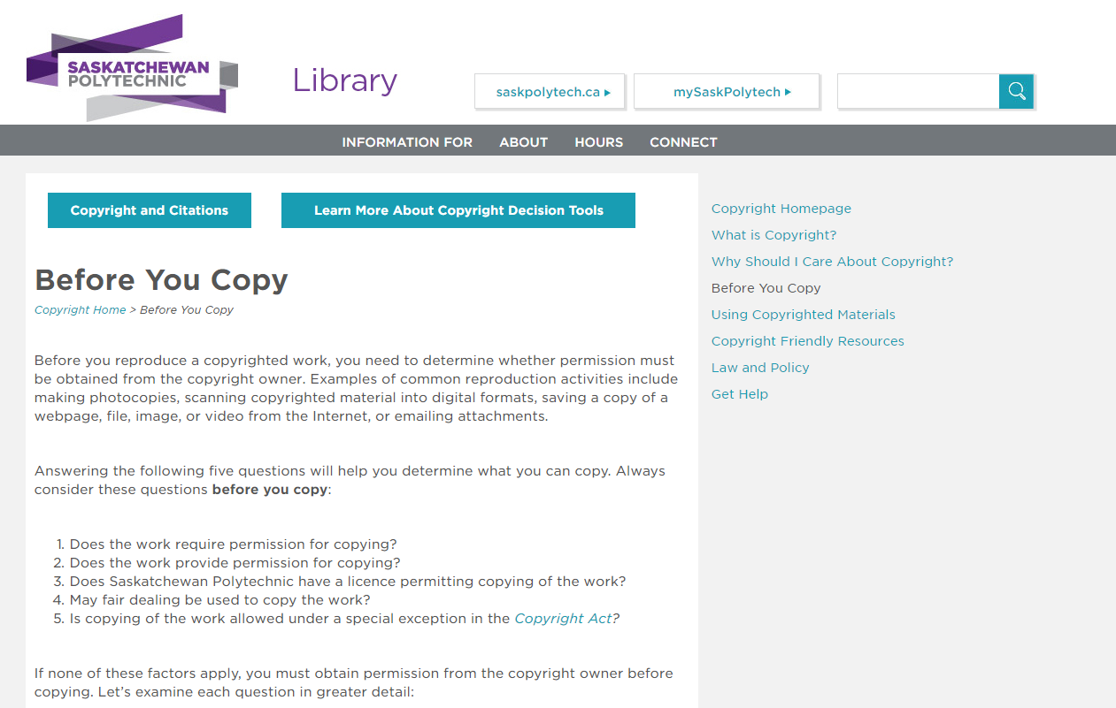

Slide 14
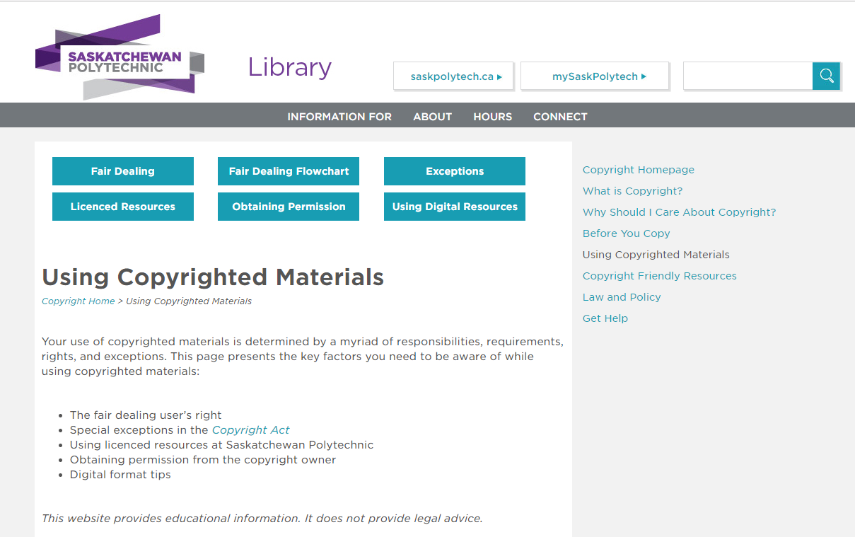

Slide 15
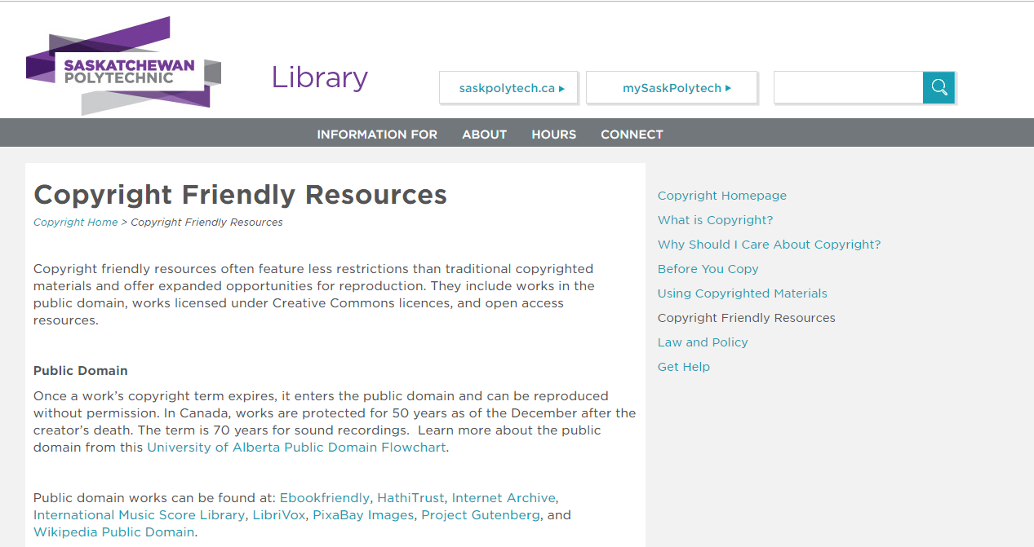

Slide 16
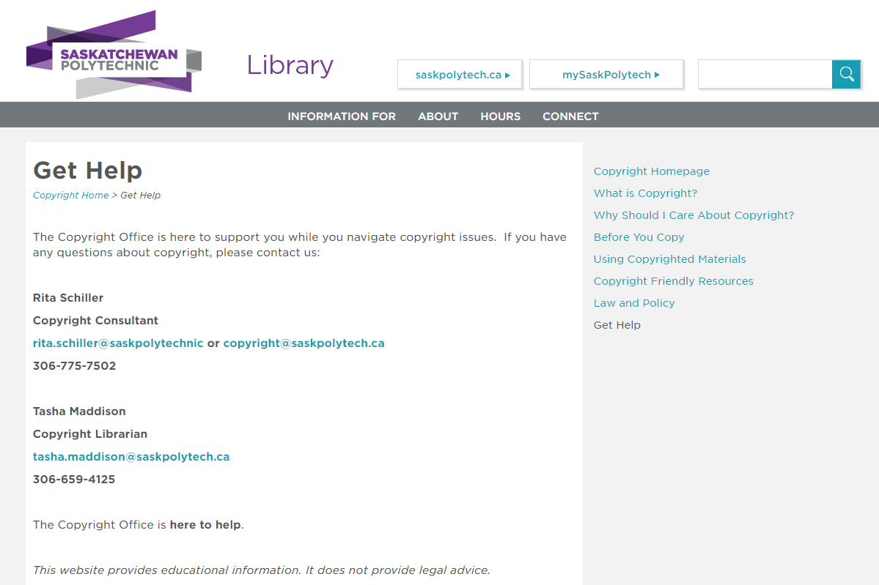

Slide 19
Questions?
Email: alan.kilpatrick@lawsociety.sk.ca
Twitter: @Alan_Kilpat
Blog: librarycanuck.com

