Slide 1
Presenting Accessibly
Strategies for Creating Accessible Conference Presentations
7 March 2024: 1:30-3:00 pm CST
Saskatchewan Library Association

Slide 2
Presenters
Riane Lapaire
  Has worked in accessibility for over a decade.
  An advocate for accessibility and with people who have disabilities.
Toward the end of the presentation, a recorded voice of my colleague Simon will be joining us for a pre-recorded demonstration.
Notes:
Chat, mute, house keeping things.

Slide 3
Land Acknowledgement
Greetings from Treaty 6 Territory and the Homeland of the Métis Nation.
As we gather from across these lands that we now call Saskatchewan. Let’s take a moment to respectfully acknowledge those lands on which we live, work, and play.

Slide 4
Presentation Overview
This presentation has 46 slides with a short body break after slide 19.
  There will be opportunities for questions between each of the 6 sections.
  We will take opportunities to practice together.

Slide 5
Disability Statistics
27% of Canadians aged 15 years and older, or 8 million people, have one or more disabilities (2017, 2022 Canadian Survey on Disability).
5.2 million Canadians have difficulty reading print material (Print Material Accessibility in Canada, 2023).
Notes:
To put this in perspective, if there are 200 people at a conference, 54 people may have a disability, and of those people, just under half may have a print disability.
If there are 20 people in your session, at least one person has a print disability. Think about that one person you may or may not be reaching.

Slide 6
Definition: Accessible
A person with a disability can acquire the same information, engage in the same interactions, and enjoy the same services or experiences as a person who is currently without disability in an equally effective and integrated manner.

Slide 7
Why Accessibility?
Legislation is coming.
To reach more people with your message.
Because we care about people, and it’s the right thing to do.

Slide 8



Poll: Base Knowledge
To tailor this presentation to those who are present today, which statement do you identify with most?:
  I am brand new to accessibility.
  I know a little bit about accessibility.
  I know lots about accessibility.
Notes:
Type in the chat, give me a verbal or non-verbal number, or a thumbs up for 1, clapping hands for 2, and an emoji with sunglasses for 3.

Slide 9
Words of Wisdom
“Avoid using the term “fully accessible”. It will likely never be possible for something to be fully accessible. But that doesn’t mean we shouldn’t still be striving toward this goal. There will always be room for and ways to improve”.
– Amanda Leduc, disabled author

Slide 10
Presentation Formats
Virtual or In-Person:
  Standard Presentations.
  Lightning Talks.
  Poster Sessions.
  Interactive Workshops.
  Roundtables.
  Panels.

Slide 11
Venue: Access Needs
Financial.
Physical/Virtual.
Sensory.
Content.
Safe Space.
Notes:
While we will be concentrating on content, I wanted to touch briefly on events as well, since many libraries plan, host, and present at all sorts of events.

Slide 12
Financial Access
Is the event free, or does it cost money to attend?
  Are there methods available for free/discounted passes to ensure the event is financially accessible?
Notes:
People with disabilities are often financially disadvantaged. Those of our colleagues with disabilities may make the same, but their expenses may be significantly higher because of their disability. (Accessible home, assistive technology and devices, etc.)

Slide 13
Physical/Virtual Access
Barrier free building and rooms
Access via public transit/walkable.
Dial-in and hybrid options.
Tips and How To Sheet for virtual platform use.
Notes:
ramps, openers, proximity to washrooms, braille signage, service animal-friendly, clear pathways, cords and cables).

Slide 14
Sensory Access
Scent-aware.
Flashing video/graphics can cause seizures.
Quiet room availability.
Body breaks.

Slide 15
Content Access
ASL interpreters.
Captions/Transcripts.
Amplification.
Printed and digital materials in accessible formats.
Described video/visual content.
Plain language.

Slide 16
Safe Space Access
Respectful language and code of conduct.
Content warnings.
Feedback methods.

Slide 17
Presenting Tips
Speak slowly, and clearly into a microphone.
Identify yourself the first time you speak or when it’s been a while since you last spoke.
Let the participants know what they’ll be expecting during your presentation.
Respect and communication.
Let your passion shine.
Notes:
A few things not mentioned specifically here is describing appearance. This is one of those personal preference things. If you decide to describe yourself, do it quickly.
For example, I have pale white skin tone with a few freckles, blues eyes, and straight medium length light brown hair. Today I’m wearing a blue shirt.
Camera on/off for online presentations. When language interpretation services are being used, and for those hard of hearing, having the video on for presenters can be helpful, however, the comfort level of the presenter should always be considered, and always a preference for attendees.

Slide 18
Poster Sessions
Inaccessible by nature, but there are ways to make them less inaccessible.
  QR codes.
    Tactile elements.
    Audio and/or video recording.
    Digital text options.
  Treat them more like described lightning talks.

Slide 19
Panels, Workshops, and Roundtables
Offer multiple ways for people to participate.
  Printed/digital materials in accessible formats prior and during the event.
  Methods to participate verbally and non-verbally.

Slide 20
Presentation Slides
Creating accessible slides can be broken down into three main sections:
Templates, Formatting, and Attributes.
Images, Graphics, and Videos.
Features and Tools.

Slide 21
Templates/Themes
Begin with an accessible template or theme but be aware that it might not actually be accessible.
  The themes and templates can be mass edited in PowerPoint using the Slide Master option in the View menu.
Create your own!
Notes:
There are some very fancy “make your PowerPoint more engaging” videos on social media right now. While they may look stunning, entire presentations of that can become a lot for some people, and they may create access problems for people using assistive technology.

Slide 22
Layout
All slides should have a unique title/heading for ease of navigation.
Use the pre-formatted slide layouts.

Slide 23
Text Attributes
Use high-contrast colours.
  Avoid using colour to convey meaning.
Choose a sans serif font with body text no smaller than 24 pt.
Limit/avoid the use of all caps.

Slide 24
Formatting Text
Use lists to organization your information.
Left justify.
White space is your friend.
Notes:
Use direct formatting options to create accessible lists. Screen readers will not identify manually created lists as lists.
Extra white space is also super handy for when you have a sign language interpreter during online events. Interpreters already steal the show, don’t need them covering up your content too!

Slide 25
Understandable Text
Use plain language.
Avoid jargon, and always spell out an acronym the first time you use it.
Use inclusive language.

Slide 26
Define Text Language
Define the language of the text in the presentation.
  People using assistive technology rely on this to ensure the text is read in the correct language.

Slide 27
Hyperlinks
Use high a high contrast colour with an underline.
When presenting use the shortest URL possible written in pascal case.
  Example: ReginaLibrary.ca
For digital handouts use informative display text.
  Example: Visit the Regina Public Library website.

Slide 28
Spot the Oops!
In the next two slides, we’ll identify some areas that can be inaccessible.

Slide 29

Makerspaces
All About My Library

Slide 30


Cool Things at My Library
3D printers
Sewing machines
LEGO
Learn to Code toys
Music instruments
Video Games
Tactile graphics creation station
Vacuum former
Board Games
Beading and looms
Print making
Visit www.mylibrary.ca/super-cool-initiatives-293723023-234298y72340928342302304928342/ to see what we’re doing with makerspaces and learning labs.

Slide 31
Images and Graphics
Ensure all images and graphics uses have high resolution.
Avoid using complex images like large comics, detailed maps, or charts with a lot of data.
  The details will often be too small for many audience members to see and absorb in a short amount of time.
Notes:
Hot tip: If you take a screen shot and then copy and paste it into your slides/documents it will have lower resolution than saving and then inserting the image itself.

Slide 32
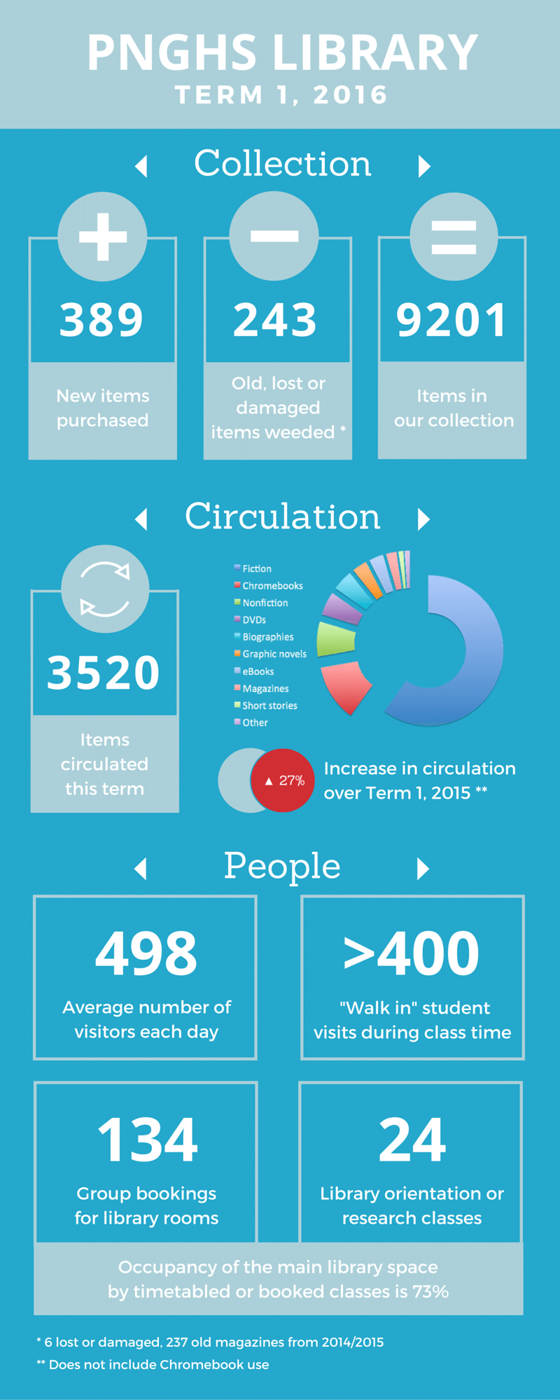
Yikes!
Notes:
This information would be best broken up into a few slides instead and presented in differ ways. Even the donut chart would be difficult to decipher on its own in a single slide.

Slide 33
Image Descriptions
If your presentation has images, the images should be described.
  This is also known as alt text.

Slide 34
Alt Text Tips
Don’t start with “This is an image/picture of…”
Write for your audience.
Use present tense and action verbs.
Describe the physical characteristics of people.
If the image contains text, transcribe it.
Do not censor.

Slide 35
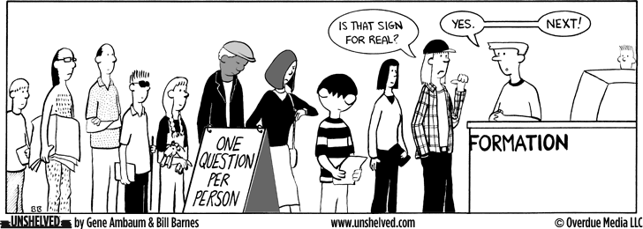
Describe Me!

Slide 36
Captions, Subtitles, and Transcripts
When presenting online, or in a recording, captions, subtitles, and transcripts should be provided.
  All should be human-edited to ensure their accuracy.
In-presentation pre-recorded multi-media should be captioned.
Notes:
Captions can be added right in PowerPoint and Google Slides. If your presentation is virtual, use only one captioning service. For example, don’t use the captions in PowerPoint and then again in Zoom.

Slide 37
Audio Descriptions
Whenever there is visual content, it should be described.
  This can be live during the presentation,
  or if the presentation is being recorded, in post-production.

Slide 38
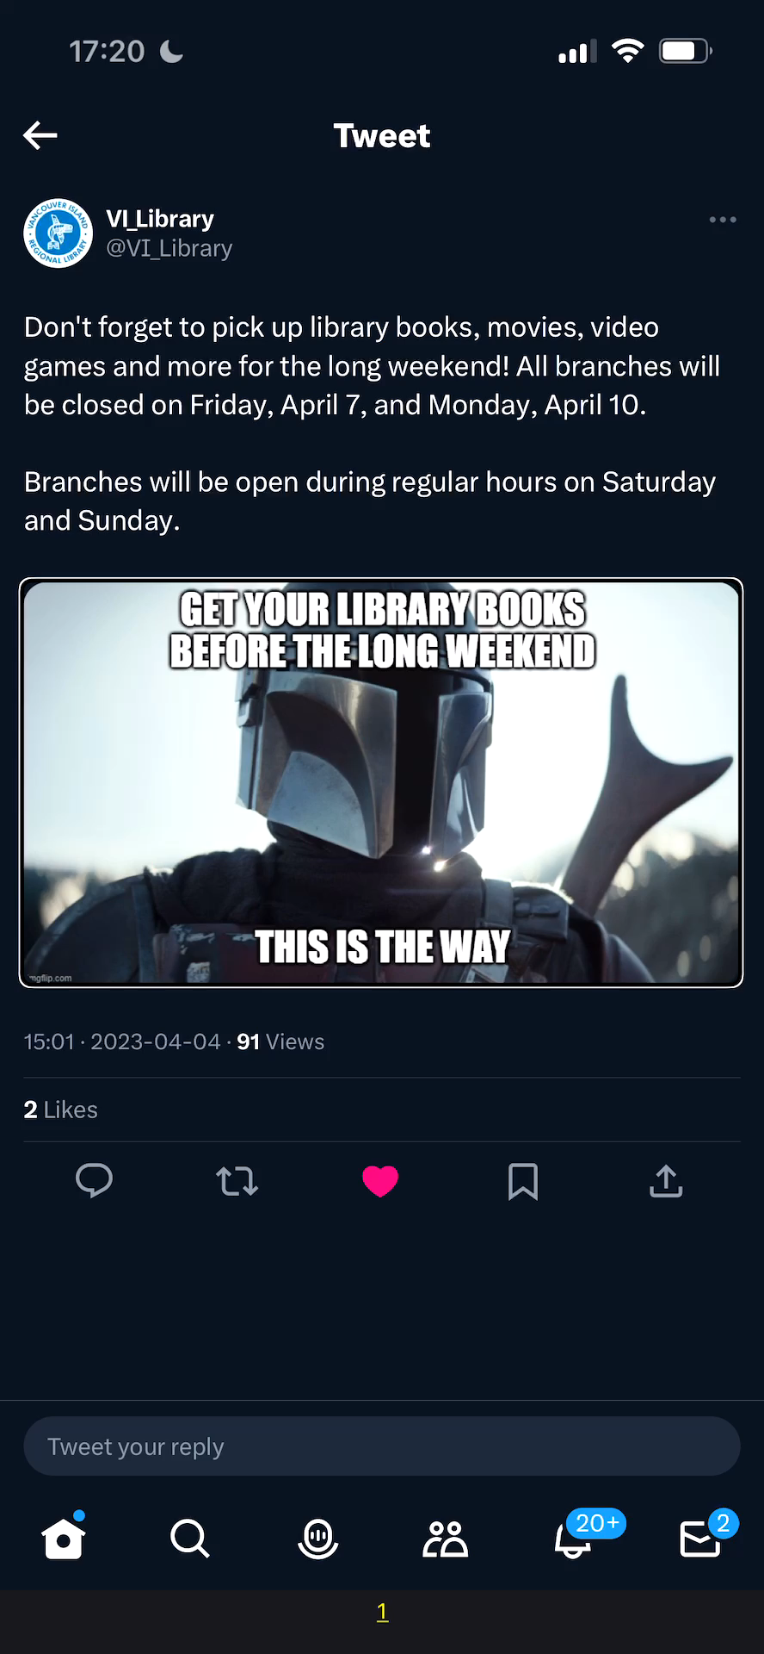
Demo
Notes:
While this demo is one for a social media post, the same concepts apply to presentations The image must be described and captioned.

Slide 39
Transitions and Animations
Transitions and animations do not communicate anything additional to attendees and can be distracting or cause motion sickness so are best avoided.
Notes:
Sometimes, animation can help viewers focus on the slide’s text, especially when there is too much text. We recommend using less text on the slide instead of animations.

Slide 40
Quote of the Year
“If you need animations to catch your audience’s attention, I’m sorry, you’re probably not giving a very good presentation anyway.”
– Melody Shih, Accessibility Consultant, NNELS

Slide 41
Drawings and Annotations
Avoid using drawings or annotations when creating slides and during the presentation.
  They are inaccessible and difficult to see.
Notes:
I truthfully didn’t know that these were a thing until someone working at and attending a conference at a university library (in Manitoba) said that he went to 6 presentations which used these.

Slide 42
Presentation Notes
If you use presentation notes and intend for those notes to be shared, make them as accessible as possible.
This field has poor contrast and can be difficult to find. To mitigate this, use:
  Large text size.
  Sans serif font.

Slide 43
Accessibility Checker
All Microsoft products have a built-in accessibility checker (Review menu) that checks for errors, warnings, and tips.
Accessibility checkers catch most things, but a human touch is still required.
Notes:
Reading order, contrast, missing alt text and captions tend to be the items caught most often.

Slide 44
Accessible Handouts
Ensure your slides are accessible so you can share them out before and after the presentation.
  Digital is often preferred.
  You can export your slides into a word document and then HTML.
  PDFs, even when properly tagged, are not accessible.

Slide 45
Let’s Try It Out
In the chat there will be a short presentation file that’s inaccessible. Let’s use what we know to fix it up.

Slide 46
Thank you!
Notes:
Resources for more learning.

