Slide 1
Plan for Emergencies Involving Physical Collections
Saskatchewan Legislative Library
Saskatchewan Libraries Conference
Saskatoon, 2May2019

Slide 2
Presentation Overview
Business Need
Developing Our Plan
Training and Research Phase
Drafting Phase
Our Plan
Next Steps

Slide 3
Revising Our Emergency Plan: Business Need
Identified as a high priority by library staff and in library strategic plan
Business continuity planning aligns with our parent organization’s strategic plan

Slide 4
Revising Our Emergency Plan: Business Need
Enhancing existing plan with additional content on:
Immediate response procedures
Management and staff roles & responsibilities
Decision-making structure
Detailed instructions for hands-on tasks
Recognized standards

Slide 5
Training and Research Phase
Training with Jane Dalley - Dalley-Froggatt Heritage Conservation Services
Emergency Management and Business Resumption Workshop - January 17th, 2018
What a good plan looks like
How to develop a plan
A Hands-on Collection Salvage Workshop - January 18th, 2018
Realistic, cost-effective salvage techniques
Dealing with wet materials

Slide 6
Training and Research Phase
Developing a Plan Workshop with Jane Dalley
Elements of a Good Plan
Risk Assessment
Prevention & Mitigation(for later development)
Response
Salvage & Recovery
Business Resumption
Staff Training
Incorporates known standards

Slide 7
Training and Research Phase
Developing a Plan Workshop with Jane Dalley
Useful Tools
Plan types, templates, examples
Risk assessment matrix
Sample hazard list
Situation assessment form
Emergency response teams
Five types of staff training
Response planning chart-provides structure for recording, preparing a response including tasks, number of artifacts, supplies & equipment needed, space needed, people and expertise required

Slide 8
Training and Research Phase
Research material:
Cleaning & salvage techniques – gave us concrete examples
Canadian Standards Association standard – we ordered this for our collection
Professional practices – we have a better sense of whom we can consult
Wet collections response flowchart – provides a decision-making tree for team leaders and staff

Slide 9
Training and Research Phase
Research material:
Drying techniques comparison – gave staff understanding of choices
Risk level – various media – helped develop triage readiness
Water health hazards – staff safety during an emergency needs special consideration and preparation
Pocket salvage guide – this could be laminated and given to team leaders in advance; it is a great one-sheet summary

Slide 10
Training and Research Phase
Research material:
Mould response guide – a succinct immediate response
Useful things in local stores – this was fun, practical
Canada Council of Archives salvage guide for water damage – a 29 page how to for all formats
Emergency Supplies & Services – a detailed equipment list and vendor list template

Slide 11
Training and Research Phase
Collection Salvage with Jane Dalley
Handling/Stabilization for Packout & Salvage
Recovering Water Damaged items
Working with different formats
Gave each staff member experience handling wet items
Practiced drying methods

Slide 12
Handling Wet Materials

Slide 13
Air Drying Methods

Slide 14
Training and Research Phase
What we learned from collection salvage training
A lot of space is required to air dry material
Advance research/arrangements for suitable space and equipment needed
Handling wet material is labour-intensive and time-consuming
Effective low-cost supplies are readily available in any hardware store
Wet items need attention within 48 hours
Freezing wet materials can buy time

Slide 15
Developing Our Plan: Drafting Phase
One year project
Team of four
By-weekly meetings
Started with Risk Assessments

Slide 16
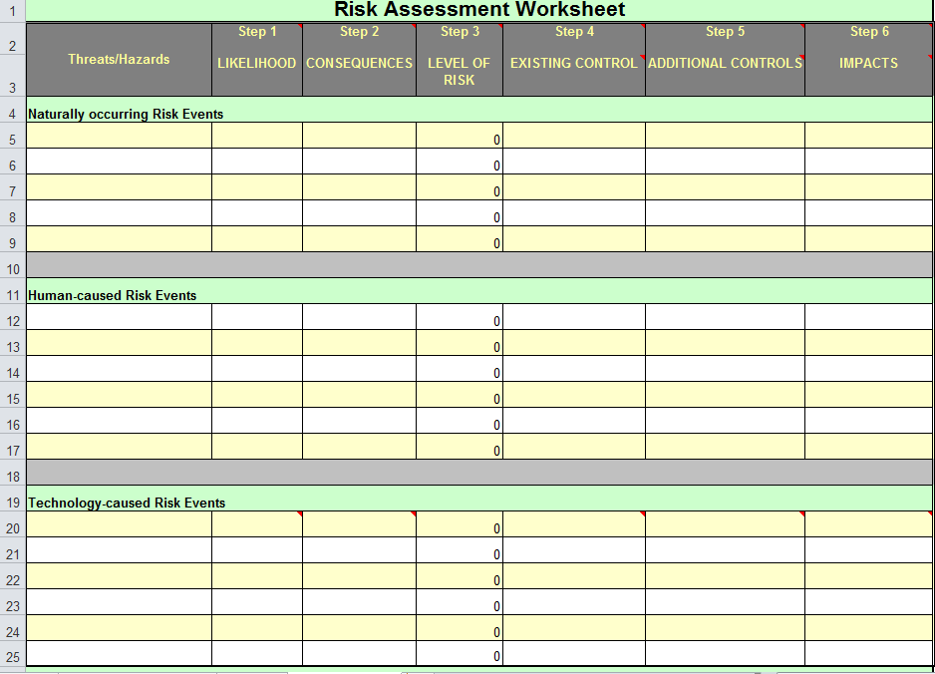

Slide 17
Drafting Phase
Risk Assessment
This first step is indicated by the Jane Dalley workshops.
Plan Writing Team shortlists risks according to likelihood and impact of each risk.
We identified 43 unique risks in 13 categories.
Narrowed down to 11 risks.

Slide 18
Eleven Key Risks
Earthquake Fire & Smoke Mould after Water Mould without Water Staff Disruption Theft | Tornado Utility Failure Vandalism Vermin Water

Slide 19
Drafting Phase
Immediate Response
Based on Risk Assessment, an immediate response plan is scripted
“Actions on” fire, flood, carpenter ants discovered
First minute, hour, especially first 48 hours
Expect interaction with external authorities and officials
Risks vary by room; responses likewise
Risks merged into each other: fire, smoke, water

Slide 20
Drafting Phase
Realistic Solutions
A good plan cannot anticipate all situations.
Match likely risks with likely responses.
Provide a toolbox of good responses from which to choose.
Provide a structured way to make decisions, marshal resources.
Pre-position supplies, equipment.
Conduct advance liaison.

Slide 21
Our Plan
safety first
risk assessments for collection spaces
only 32 pages
defines roles and responsibilities

Slide 22
Our Plan
Four Sections
Discovery and Response
Recovery
Documentation & Debriefing
Appendices with detailed information

Slide 23
Nine Common Steps in a Standard Response for Every Disaster Scenario
Discovery
Scene Assessment
Engage Team Lead
Situation Report
Inform Librarian
Response
Recovery
Incident Report
Debriefing

Slide 24
Team Lead
Provides direction & support
Channels communication
Coordinates efforts
Documents incident
Conducts debriefing

Slide 25
Empowerment
At discovery all staff can respond
All staff have access to the Plan
Appendices provide support
Everyone contributes to Debriefing
Everyone helps refine the Plan

Slide 26
Collection Material Triage
Plan identifies priority collections
Priority collections provides guidance for triaging material when necessary
Collection priorities are drawn from the Library’s mandate and its collection and preservation policies

Slide 27
Appendices
Book Repair Manual
Floor Plans, Risk Assessments
Resource list with detailing guidance and procedures
Policies, Contacts, Supplies
Previous Incidents

Slide 28
Incident Report
What, where, when, why, who
Includes point from Debriefing
Written by the Team Lead
Is referenced in the Plan

Slide 29
Debriefing
What went well, points to improve
Hears from all staff involved
Conducted by the Team Lead
Is referenced in the Plan
Strengthens future responses

Slide 30
Next Steps
Present Plan to Staff
The Project Team presents Plan to rest of staff
Acquire & Install Supplies & Equipment
As determined by Plan and supporting documents, training
Training Scenarios & Rehearsals
Tabletop/Sandbox exercise or hands-on scenarios
External Liaison
With facilities staff, security, emergency personnel
Renewal and Revision
Management responsibility to ensure rehearsals, review, revision occur

Slide 31
Next Steps
Rehearsals
Scenario-based training.
Rehearsals will foster plan revision and improvement.
Practice will help work out bugs in communication, decision-making, and improve the speed of response.
Rehearsals afford “what-if” experimentation: what if key decision-makers named in the plan are not available during a crisis?

Slide 32
GC Salmers
Director of Support Services
Saskatchewan Legislative Library
211-3085 Albert St. Regina, SK
S4S 0B1
1-306-787-2278
gsalmers@legassembly.sk.ca
http://www.legassembly.sk.ca/library/

