Slide 1
Indigenization in Libraries Panel Friday, May 3, 2019 2:45 – 4:00 pm

Slide 2
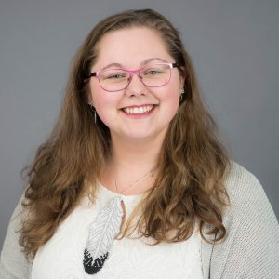
Lorisia MacLeod Instruction Librarian
Notes:
Lorisia MacLeod is a proud member of the James Smith Cree Nation and an Instruction Librarian at NorQuest College.
As an avid reader of comics and a Cree learner, Lorisia has been involved in projects focusing on the diversification/development of library collections especially relating to comics or language materials.
Last summer, Lorisia created templates of citing Indigenous Elders and Knowledge keepers that work with APA or MLA style.
Recently, she has been looking at ways to integrate new tech (3D printing, VR, AR) into Indigenous language learning and retention.

Slide 3
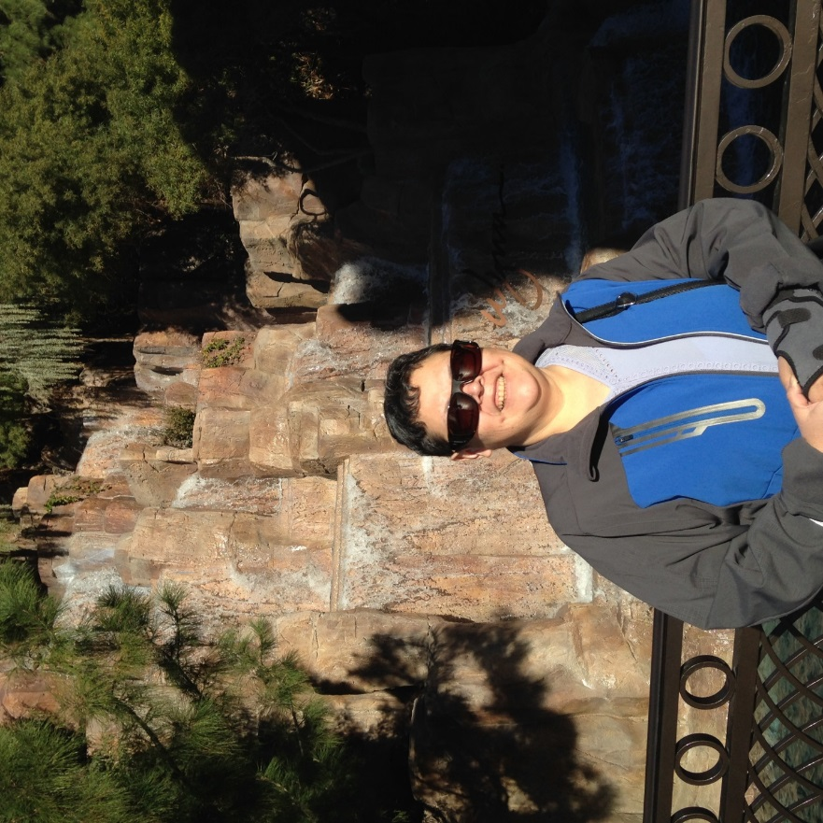
Harriet Roy Teacher Librarian, Assistant Director, LSSAP Chair
Notes:
Harriet Roy has been with PNLS headquarters for the past 23 years, fulfilling various duties and also participating in a variety of Library/Literacy related committees. She is currently the Chairperson of the Library Services for Saskatchewan Aboriginal Peoples Inc., Secretary for Kewetin Nene Reading Council, now called Literacy Educator’s Network of Saskatchewan.
She received her Bachelor of Education from the University of Regina and Northern Teacher Education Program and taught in her home community of Beauval before moving to La Ronge to fulfill a dream of being a Librarian. She received a Certificate of Library Training from Red River College offered through the Credenda Program in Saskatchewan.
She continues to advocate for Literacy skill building for the people of Northern Saskatchewan by sitting on committees whose mandate is literacy focused.
Life is busy with work, grown children and 7 grandchildren.

Slide 4
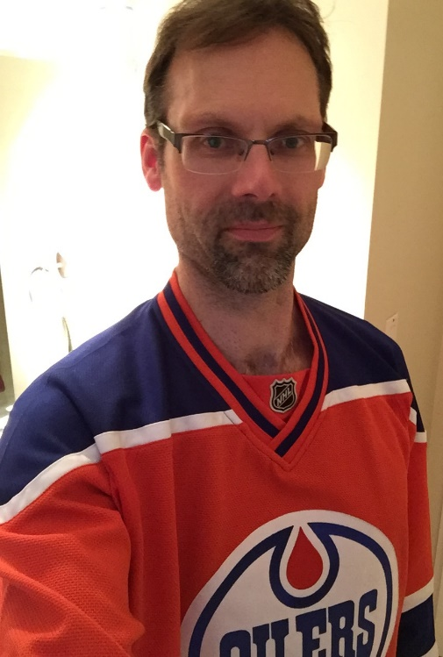
Michael Shires Collection Development & Liaison Librarian Michael.Shires@uregina.ca ORCID iD: 0000-0002-7912-5767
Notes:
Michael is a settler and was born and raised in ᐊᒥᐢᑲᐧᒋᐋᐧᐢᑲᐦᐃᑲᐣ / Amiskwacîwâskahikan/Edmonton - Treaty 6 Land
Employed in Treaty 4 Land at Univ. of Regina Dr. John Archer Library since 2010
Subject librarian for Economics, Government Publications, Indigenous Studies, and Special Collections
MLIS from the Univ. of Alberta
Previously worked in public and academic libraries in the United States and the United Arab Emirates
Served 2 terms on Multitype Library Board and 6 years on Saskatchewan Library Association Board
Published 5 articles and details are in his ORCID iD on the slide

Slide 5
Wendy Sinclair Albert Branch Head, Indigenous Services Advisor
Notes:
Wendy has worked for the Regina Public Library for the past 34 years.
She is the Albert Branch Head and has recently taken on an additional role as the Indigenous Services Advisor at RPL.
She will be working together with community partners to develop an indigenous services strategy that encompasses the Principles of Reconciliation and responds to the Truth and Reconciliation’s Calls to Action.

Slide 6
Panel Question 1
Describe one initiative that has worked well,
and one that didn’t work quite as well.

Slide 7
Panel Question 2
What initiatives or programs would you like your institution
to consider undertaking in the near future?

Slide 8
Panel Question 3
How would you define the term Indigenization ?
How about Decolonization ?

Slide 9
Panel Question 4
What role do you see SLA play in the Indigenization
of Saskatchewan’s library community?

Slide 10
Thank you for attending

