Slide 1
Part 2

Slide 3
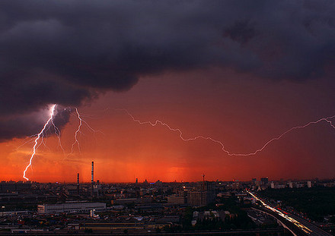
Environmental Crisis Example: Tornado / Hurricane Immediate Response: Shock Public safety & concern for those affected Discuss impact on the library and staff Regularly update the community on recovery Actions: Reach out and help those affected Talk to staff…lots….so they can talk to customers…lots!

Slide 4
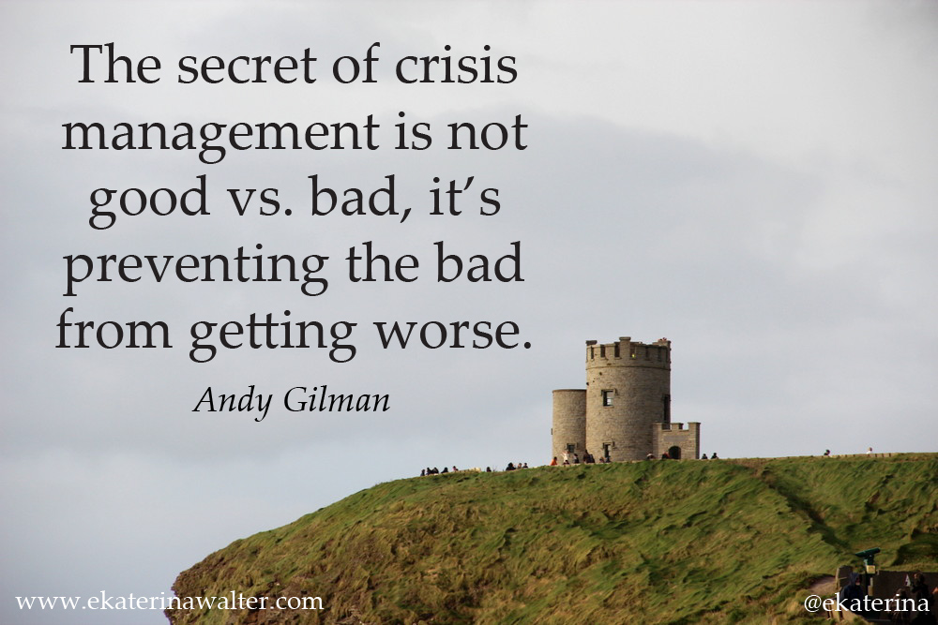

Slide 5
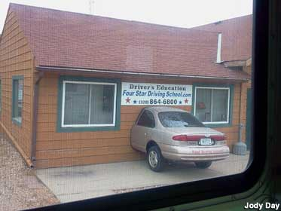
Facilities Crisis: Example: flood/fire Immediate Response: Shock “We have called the exterminator/roofer..” Give staff talking points about the facts and actions to restore regular operations Regularly update the community on repairs Actions: Do not hesitate… call in the professionals there is no “home remedy” here Publically post the “ALL Clear” report Turn the crisis into a “teachable” moment

Slide 7
Customer Crisis: Example: pornography / theft Immediate response: Express shock and then step aside, and be quite so it can become yesterdays story If it’s a police issue – no comment is the only correct comment Actions: Follow All library policies and procedures …exactly At the board meeting review □ relevant library policies and □ library security procedures

Slide 8
“Surviving a crisis is all about; a positive attitude honest communications actions and learning from the experience”.

Slide 9
Employee Crisis: Example: staff misuse credit card work stoppage Immediate Response: This is a personnel issue so - no comment is the only comment Actions: Stay positive Follow All library policies and procedures …exactly At the board meeting review □ relevant library policies and □ library security procedures

Slide 10
“If you don’t talk about it and take action someone else will”. Kitty Pope

Slide 11
Board crisis: Example: Loss of funding Immediate responses: “ The board is committed to investigating and correcting the situation.’ And then regularly engage the community Actions: All hands on deck …Board members, staff & customers, everyone needs to reach out and promote the library This is not the time to cut the marketing budget! Explain why the library is a vital & relevant again & again Testimonials from community leaders and library users are the most powerful advocates to reach out and influence the decision makers.

Slide 12
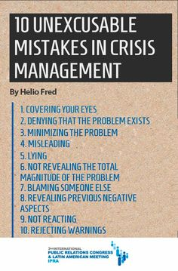

Slide 13
What to do? 1. Step up and be a leader. this is the time! Be proactive and positive Surviving a crisis is about a positive attitude, honest communications, actions and learning from the experience.

Slide 14
2. HONESTY IS THE BEST POLICY. If you don’t know the answer Say so. Find the answer, and get back to the person. The mistake that moves a crisis to a disaster is not Accurately answering the question.

Slide 15
3. Actions speak louder than words.

Slide 16
4. It takes 8 positive stories to forget 1 negative one. Create positive media releases in the months after a crisis to rebuild credibility i.e. What Melfort read in 2016 How to Festival Every month release a “feel good” media story

Slide 17
“A crisis does not have to turn into a disaster.”

Slide 18
5. Be prepared keep an emergency file @ work & home which includes; □ Phone numbers and email addresses □ Library floor plans □ Library keys..including the book drop! □ Blank media release template and media contacts □ Copies of this workshop!

Slide 19
6. There is no “magic bullet”, crisis management is a process, a series of ongoing actions that will make the library stronger.

Slide 20
Bad libraries are destroyed by crisis. Good libraries survive them. Great libraries are improved by them.

